Slide 1
Transforming healthcare
Michele Tringali
Ministero della Salute
Direzione Generale della Programmazione sanitaria – Roma, Italia
m.tringali@sanita.it
Presented herein are the author’s opinions. No implied endorsement may be expected by Ministry of Health, Italy.

Slide 2
BEFORE TRANSFORMING HEALTH CARE THROUGH AI,
(OR ANY OTHER MITH OR BELIEF)
LET’S US UNDERSTAND WHAT HEALTH CARE ACTUALLY IS,
WHAT ARE THE BASIC ORGANISATION PATTERNS
AND HOW DOES IT WORK

Slide 3
WHAT IS A HEALTH CARE SYSTEM
The health care system is just one piece of the more comprehensive welfare system, whose other parts are: social services, work access and protection systems, pension system.
The need for public intervention in the field of health is linked to the definition of the good of health as a merit good and also to some peculiarities of the health sector compared to other economic sectors.
These peculiarities concern the presence in the health sector of: externality phenomena, monopolistic forms in the supply system, information asymmetry between patient and doctor / health facility, significant economies of scale.
Reprinted, from: Il contesto europeo del nuovo Patto per la salute. Adeguamenti, riforme e sistemi di classificazione dei sistemi sanitari in Europa. Filippo Palumbo. Quotidiano Sanità 27.03.2019.

Slide 4
MERIT GOODS
Goods or services whose consumption is believed to confer benefits on society as a whole greater than those reflected in consumers' own preferences for them. A good may be classed as a merit good if it causes positive externalities when it is consumed. Education is typically cited as an example. In the absence of government intervention individual choice will lead to under-consumption of a good causing a positive externality. Such merit goods are therefore sometimes subsidized by the government, or directly provided. A good can also be classed as a merit good through paternalism: the government decides that it is better informed than consumers about what is good for them, and chooses to override consumer sovereignty to ensure consumption. Examples are compulsory primary education and compulsory vaccination of children in many countries.
From: merit goods in “A Dictionary of Economics”
Subjects: Social sciences — Economics
https://www.oxfordreference.com/display/10.1093/oi/authority.20110803100151458 .

Slide 6
WHAT ARE THE MAIN FUNCTIONS OF A HEALTH CARE SYSTEM
Health systems can be broadly identified as systems that perform two health functions:
- productive function of the health asset as a complex of operators, structures, performances, services and activities aimed at maintaining and promoting health;
- insurance function as a set of rules and apparatuses capable of guaranteeing access to appropriate health services in specific contexts characterized by specific economic, legal, social and cultural factors.
Reprinted, from: Il contesto europeo del nuovo Patto per la salute. Adeguamenti, riforme e sistemi di classificazione dei sistemi sanitari in Europa. Filippo Palumbo. Quotidiano Sanità 27.03.2019.

Slide 7
THE HEALTH TRIANGLE: INSURERS, PROVIDERS AND USERS
INSURERS are those who collect - with or without profit - financial resources to be used to pay the medical expenses of third parties. SUPPLIERS (or PROVIDERS) are the subjects who directly provide health services, i.e. hospitals, clinics, doctors, nurses, and in general all health organisations and professions. Depending on how providers and insurers are brought together by REGULATIONS, seven different healthcare system models can be implemented:
INSURER
PROVIDER
REGULATION
Modified, from: Vittorio Mapelli - Il sistema sanitario italiano. Il Mulino editore, 2012. Toth F: Non solo Bismarck contro Beveridge: sette modelli di sistema sanitario, Rivista Italiana di Politiche Pubbliche, 2;2016. Citati in: Il Servizio sanitario nazionale non è più una “cosa” scontata di Filippo Palumbo. Quotidiano Sanità 08.05.2023.

Slide 8
THE HEALTH TRIANGLE: USERS, PROVIDERS AND INSURERS
INSURER
PROVIDER
USER
REGULATION

Slide 9
1. Direct or simple market
The figure of insurers is missing here. The direct market is present in all countries. The state regulates suppliers only from the point of view of safety, but does not intervene in the relationship between users and suppliers. In Italy, it mainly concerns dental care.
PROVIDER
USER
REGULATION
Modified, from: Toth F: Non solo Bismarck contro Beveridge: sette modelli di sistema sanitario, Rivista Italiana di Politiche Pubbliche, 2;2016. Citato in: Il Servizio sanitario nazionale non è più una “cosa” scontata di Filippo Palumbo. Quotidiano Sanità 08.05.2023.

Slide 10
2. Voluntary insurance
Insurers are also present here. The State can regulate and supervise not only providers, but also insurance companies, in order to prevent the latter from engaging in opportunistic behaviour to the detriment of users. Legislation may also provide for tax or monetary incentives for those who take out insurance, or - on the contrary - penalties for those who, despite having the means to do so, do not insure.
For example, if you reside in the United States, you can take out a policy directly or through your company that can get more advantageous purchase costs. Obamacare has attempted to act at this level, favoring a sort of controlled insurance market.
INSURER
PROVIDER
USER
REGULATION
REGULATION
Modified, from: Toth F: Non solo Bismarck contro Beveridge: sette modelli di sistema sanitario, Rivista Italiana di Politiche Pubbliche, 2;2016. Citato in: Il Servizio sanitario nazionale non è più una “cosa” scontata di Filippo Palumbo. Quotidiano Sanità 08.05.2023.

Slide 11
3. Social sickness insurance
It is a system in which a multiplicity of non-competing funds operate. It is based on the compulsory membership of a health insurance fund for each occupational category. It is, therefore, an employment system, linked to work and not to residence.
SSI systems therefore have an intrinsic criticality: unless they are accompanied by some residual program, they generally do not guarantee insurance coverage for the entire population.
INSURER
PROVIDER
WORKING USER
REGULATION
Modified, from: Toth F: Non solo Bismarck contro Beveridge: sette modelli di sistema sanitario, Rivista Italiana di Politiche Pubbliche, 2;2016. Citato in: Il Servizio sanitario nazionale non è più una “cosa” scontata di Filippo Palumbo. Quotidiano Sanità 08.05.2023.

Slide 12
4. Residual Programs
Programmes for the protection of health and the provision of health services aimed at certain professional categories or groups of the population at risk. The residual programmes are therefore borne by the whole community: they are financed by general taxation or by special purpose taxes.
In the U.S., the main ones are the Medicare and Medicaid programs, both established in the mid-1960s under the presidency of Lyndon Johnson. Medicare provides health coverage to citizens over the age of 65, with an annual co-payment: reimbursement of medical, hospital and drug expenses. Medicaid is funded in part by the federal government and in part by individual states, and is aimed at the poorest sections of the population and people with disabilities. Each state may establish different forms of protection and different criteria for access.
INSURER
PROVIDER
SOME USER
REGULATION
Modified, from: Toth F: Non solo Bismarck contro Beveridge: sette modelli di sistema sanitario, Rivista Italiana di Politiche Pubbliche, 2;2016. Citato in: Il Servizio sanitario nazionale non è più una “cosa” scontata di Filippo Palumbo. Quotidiano Sanità 08.05.2023.

Slide 13
5. Compulsory National Insurance
Countries that oblige their citizens to take out a health insurance policy. The state regulates the insurance market and, if necessary, adopts residual programs. Examples: USA, Switzerland.
There is no single public scheme to which contributions can be paid: the policy can be purchased from a plurality of insurers, from which citizens can choose. Insurers can be for-profit insurance companies or non-profit mutual funds. By obliging all residents to obtain insurance coverage, the state can provide economic subsidies for low-income citizens and can impose a regulation, even a very strict one, of the insurance market. All residents are required to obtain health insurance, and each pays their own policy premium. The policies may be different from each other, and may also cover additional levels to the minimum ones set by law: possible differences in treatment must therefore be taken into account. The providers are independent of the insurance companies, which reimburse the costs incurred.
INSURER
PROVIDER
RICH USER
REGULATION
Modified, from: Toth F: Non solo Bismarck contro Beveridge: sette modelli di sistema sanitario, Rivista Italiana di Politiche Pubbliche, 2;2016. Citato in: Il Servizio sanitario nazionale non è più una “cosa” scontata di Filippo Palumbo. Quotidiano Sanità 08.05.2023.

Slide 14
6. Universalistic single payer system
The state acts as an insurer for the entire population, but it does not act as a provider. The State has a regulatory role in relation to the providers. It is a single insurance scheme for the entire population, financed by general taxation and intended to guarantee the health care deemed necessary. It is universalistic with a single payer: the state together with local institutions.
It covers all residents: it is not linked to the regular payment of contributions or an insurance premium, but to the residence. Health care thus becomes a right of citizenship. Treatment can be provided free of charge in whole or in part (co-payment, usually small, at the patient's expense). Canada, with its Medicare, is an example of this.
ONE STATAL INSURER
PROVIDER
USER
REGULATION
Modified, from: Toth F: Non solo Bismarck contro Beveridge: sette modelli di sistema sanitario, Rivista Italiana di Politiche Pubbliche, 2;2016. Citato in: Il Servizio sanitario nazionale non è più una “cosa” scontata di Filippo Palumbo. Quotidiano Sanità 08.05.2023.

Slide 15
7. National Health Service
The State, together with local institutions, if any, acts as both insurer and provider. The right to care is linked to residence and not to employment.
For its function as a service provider, the State may make use of accredited private entities by providing for remuneration on the basis of tariffs.
INSURER
PROVIDER
USER
REGULATION
Modified, from: Toth F: Non solo Bismarck contro Beveridge: sette modelli di sistema sanitario, Rivista Italiana di Politiche Pubbliche, 2;2016. Citato in: Il Servizio sanitario nazionale non è più una “cosa” scontata di Filippo Palumbo. Quotidiano Sanità 08.05.2023.

Slide 16
 | 7 Healthcare System Models | Prevailing Mode | Add-on Mode
1 | Direct or simple market |  | All countries
2 | Voluntary insurance |  | All countries
3 | Social sickness insurance | Austria, Belgium, France, Germany, Luxembourg, Turkey - Japan | Portugal, Spain
4 | Residual Programs | USA | France, Germany, Netherlands, Turkey - Japan
5 | Compulsory National Insurance | Switzerland, USA
6 | Universal single payer system | Australia, Canada
7 | National Health Service | Denmark, Finland, Ireland, Iceland, Italy, Norway, Portugal, United Kingdom, Spain, Sweden - New Zealand
Modified, from: Toth F: Non solo Bismarck contro Beveridge: sette modelli di sistema sanitario, Rivista Italiana di Politiche Pubbliche, 2;2016. Citato in: Il Servizio sanitario nazionale non è più una “cosa” scontata di Filippo Palumbo. Quotidiano Sanità 08.05.2023.

Slide 17
HOW AI PRODUCTS WILL IMPACT A HEALTH CARE SYSTEM?
CENTRALISED
INSURER
PROVIDER
DECENTRALISED
USER
Health law page – WHO: https://www.who.int/health-topics/health-law#tab=tab_1
Field RI. Why is health care regulation so complex? P T. 2008 Oct;33(10):607-8. PMID: 19750043 https://www.ncbi.nlm.nih.gov/pmc/articles/PMC2730786/
Health care regulation
Health care programming
Health care management
REGULATION

Slide 18
Health care regulation is a form of social control which is exerted by the more stable organizations of society, such as established institutions and the law. They are ordinarily embodied in definite codes, usually written (MeSH NLM).
Health care programming: health insurance plans intended to reduce unnecessary health care costs through a variety of mechanisms, including: economic incentives for physicians and patients to select less costly forms of care; programs for reviewing the medical necessity of specific services; increased beneficiary cost sharing; controls on inpatient admissions and lengths of stay; the establishment of cost-sharing incentives for outpatient surgery; selective contracting with health care providers; and the intensive management of high-cost health care cases (Managed Care Programs, MESH NLM).
Health care management is the planning, administration, and management of all health care systems, hospitals, and other medical facilities.

Slide 19
Three challenges for any healthcare system
Widening staff shortages and skill gaps
Unsuccessful efforts to shift from episodic care-based systems to proactive and long-term care management systems
Financial unsustainability
Adapted, from: EIT Health, McKinsey &Co: Transforming healthcare with AI - The impact on the workforce and organisations. March 2020

Slide 20
SOURCES OF INEFFICIENCY IN HEALTH CARE SERVICES – 1/2
• Payment for wrong outputs (units of service rather than episode of illness, health outcomes, or covered lives)
• Financial incentives that reward inefficiency (complications or readmissions)
• Lack of price information and incentives for patients
• Indifference of providers to induced costs (e.g. hospital driven costs imposed to community care)
• Dysfunctional competition rather than performance-based competition
• Lack of personal or professional ethos to care about societal costs of health care
• Failure to take full advantage of professional skills of nurses (and other types of profession)
• Lack of uniform systems and processes to ensure safe and high-quality care
• Uneven patient flows, resulting in overcrowding, suboptimal care, and waste
• Insufficient involvement of patients in decision making (as in end-of-life care)
• Insufficient attention to prevention, disparities, primary care, health literacy, population health, and long-term results
Fineberg HV. Shattuck Lecture. A successful and sustainable health system--how to get there from here. N Engl J Med. 2012 Mar 15;366(11):1020-7. doi: 10.1056/NEJMsa1114777. PMID: 22417255

Slide 21
SOURCES OF INEFFICIENCY IN HEALTH CARE SERVICES – 2/2
• Fragmented and uncoordinated delivery, without continuity of care
• Lack of information on resource costs, performance, comparative effectiveness, quality of care, and health outcomes
• Scientific uncertainty about effectiveness and cost, especially of newer tests and treatments
• Cultural predisposition to believe that “more care is better”
• Administrative complexity of coping with forms, regimens, and requirements of different insurers
• Rewarding of inventors and entrepreneurs for possible performance advantage more than for significant savings in overall system cost
• Regulatory regime that can only retard and not accelerate innovation
• Insufficient reliance on competitive bidding for drugs and devices
• Distortions resulting from frauds, conflicts of interest, and a dysfunctional malpractice system
Fineberg HV. Shattuck Lecture. A successful and sustainable health system--how to get there from here. N Engl J Med. 2012 Mar 15;366(11):1020-7. doi: 10.1056/NEJMsa1114777. PMID: 22417255

Slide 22
1. The current system of health technology development for health prevention and care is full of misalignments
2. Almost nobody fully understands what is going on
3. There is much avoidable waste
Greenhalgh, Trisha; Fahy, Nick; Shaw, Sara (2018): The Bright Elusive Butterfly of Value in Health Technology Development. International journal of health policy and management n. 1, 7, pp. 81–85. DOI: 10.15171/ijhpm.2017.65.
Gap | Innovation | Value Proposition | Reality check
Limitations and risks in mammography | Optical molecular imaging device for breast cancer diagnosis and characterisation | Providing early breast cancer diagnostic and monitoring treatment more safely | Still underperformed by X-rays after 20 years of S&D
Excess of neo-adjuvant chemotherapy for non invasive breast cancer | Predictive / prognostic genomic tests | Avoiding unnecessary chemotherapy and personalising treatment according to prognosis | Advanced immuno-hystochemistry is offering same value, at a fraction of the costs
Limitations and risks in orthopaedic MIS - minimally invasive surgery | Computer-assisted navigation system to support MIS orthopaedic surgery such as hip, knee, and spine implants | Increasing accuracy in orthopaedic surgical practice and reducing complications | Differences in clinical outcomes still in the eyes of the believer
Poor management of chronic illness and uncoordinated services | Home telehealth solution comprising a set of coordination tools to promote continuity of care for chronically ill patients | Improving the management of chronically ill patients and preventing the use of costly resources through home monitoring and patient empowerment | COVID-19 as the nemesis of EBM
Modified from: Lehoux, Pascale; Miller, Fiona A.; Daudelin, Geneviève; Denis, Jean-Louis (2017): Providing Value to New Health Technology: The Early Contribution of Entrepreneurs, Investors, and Regulatory Agencies. In: International journal of health policy and management n. 9, 6, pp. 509–518. DOI: 10.15171/ijhpm.2017.11.

Slide 23
AREAS OF CLINICAL APPLICATIONS and some examples
- Clinical Management: coordinating and integrating information, identifying patients for screening examinations, prioritizing patients for immediate interpretation, standardizing reporting
- Radiomics: the conversion of medical images into complex quantitative data
- Genomics: the conversion of gene variants into complex quantitative data which can be analyzed to support diagnoses and develop new DSS
- Digital Pathology, Tele-pathology
- Digital Dermatology, Tele-dermatology
- Genome editing of human embryos (UK 2017)
- Clinical Research
- Psychiatry: chatbots, or conversational agents, i.e. programs that mimic conversation using text or voice and may also include a virtual, human-like, presence (an embodied conversational agent). Support or supplement for moderators of online communities for youth mental health
- Critical care and hospitalization (i.e. federated AI model for accurate prediction of COVID-19 prognosis)
- Upcoming dystopia? Devices that observe, capture, and analyze behaviour in the real world (i.e. outside of a clinician’s office) as new tools to personalize care
CADTH ISSUES IN EMERGING HEALTH TECHNOLOGIES: An Overview of Clinical Applications of Artificial Intelligence. Issue 174, 2018

Slide 24
POTENTIAL USES OF HEALTH IT - AND SPECIFICALLY OF AI
• Personal medical records
• Personalized health reminders and follow-up
• Personal health, diet, and activity monitoring and motivation
• Pre-degree and continuing medical education
• Real-time clinical decision support
• Remote professional consultation and care
• Monitoring and advising of patients with chronic disease
• Quality assurance
• Performance assessment of providers and institutions
• Comparative outcomes research
• Matching of potential participants to clinical trials
• Monitoring for safety (or unanticipated benefits) of drugs, devices, diagnostic tests, surgery
• Enhanced peer-to-peer and professional–patient support
• Comparative health assessments across populations, communities, cities, and states
• Public health surveillance for disease outbreaks, environmental risks, and potential bioterrorism
Fineberg HV. Shattuck Lecture. A successful and sustainable health system--how to get there from here. N Engl J Med. 2012 Mar 15;366(11):1020-7. doi: 10.1056/NEJMsa1114777. PMID: 22417255

Slide 25
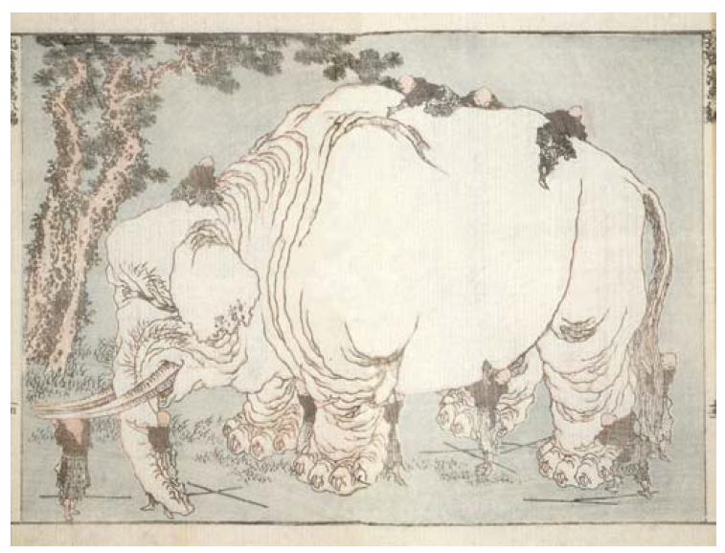
WHAT AI IN HEALTH CARE IS
HOW IT MAY BE USED
HOW IT WILL BE UNDERSTOOD AND VALUED
Eleven blind Buddhist monks examine an elephant but fail to agree upon a definition.
An illustration of the old fable by the Japanese artist Hokusai Katsushika (1760–1849)

Slide 26
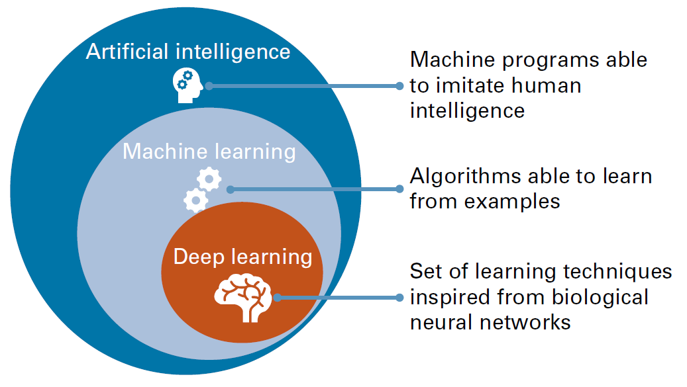
AI is a branch of computer science concerned with the development of systems that can perform tasks that would usually require human intelligence, such as problem-solving, reasoning, and recognition.
AI is an umbrella term encompassing a number of subfields and approaches.
Zerka F et al: Systematic Review of Privacy-Preserving Distributed Machine Learning From Federated Databases in Health Care. JCO Clinical Cancer Informatics 2020 :4, 184-200

Slide 27
MeSH Browser https://meshb.nlm.nih.gov/search
MeSH Heading Artificial Intelligence
Tree Number(s) G17.035.250 L01.224.050.375
Unique ID D001185
RDF Unique Identifier http://id.nlm.nih.gov/mesh/D001185
Scope Note
Theory and development of COMPUTER SYSTEMS which perform tasks that normally require human intelligence. Such tasks may include speech recognition, LEARNING; VISUAL PERCEPTION; MATHEMATICAL COMPUTING; reasoning, PROBLEM SOLVING, DECISION-MAKING, and translation of language.
Entry Term(s)
AI (Artificial Intelligence), Computational Intelligence, Computer Reasoning, Computer Vision Systems, Knowledge Acquisition (Computer), Knowledge Representation (Computer), Machine Intelligence
Previous Indexing Computers (1966-1985)
See Also Heuristics
Date Established 1986/01/01
Date of Entry 1985/06/06
Revision Date 2017/07/03
Allowable Qualifiers
classification (CL)
economics (EC)
ethics (ES)
history (HI)
legislation & jurisprudence (LJ)
standards (ST)
statistics & numerical data (SN)
supply & distribution (SD)
trends (TD)

Slide 28
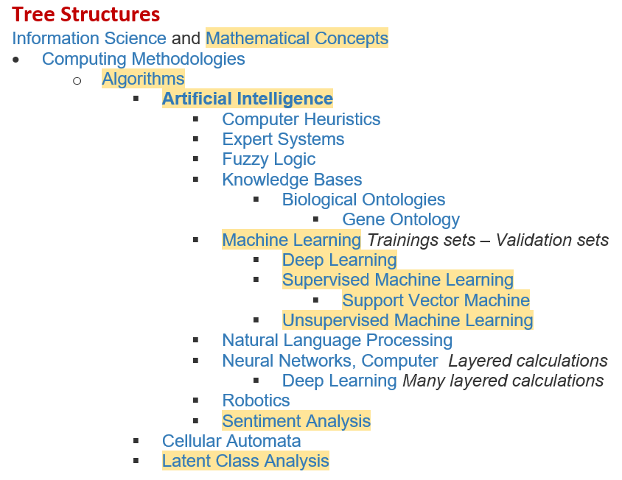

Slide 29
CLINICAL APPLICATIONS
Improving precision (e.g. Parkinson’s disease score and other scores), accuracy, speed, safety (e.g. PET radio nuclide doses, CT scan doses) of diagnosis;
Improving prediction, efficiency and quality (e.g. personalized patient treatment plans, i.e. a form of cognitive computing for oncologysts and others; robot-assistive rehabilitation) of therapy, of prognosis;
Both within a mixed-supervised or a fully automated operation model, in several areas:
CADTH ISSUES IN EMERGING HEALTH TECHNOLOGIES: An Overview of Clinical Applications of Artificial Intelligence. Issue 174, 2018

Slide 30
AREAS OF NOT-CLINICAL APPLICATION
- Health Research
- Drug Discovery and Development
Some pitfalls, too …
«The Public Health Agency of Canada’s Global Public Health Intelligence Network is an example of an early (and still evolving) AI-based surveillance system that has detected early signals for severe acute respiratory syndrome in 2003 and Middle East respiratory syndrome coronavirus in 2012, as just two examples of its successes»
BUT IT DID NOT WORK FOR COVID-19
CADTH ISSUES IN EMERGING HEALTH TECHNOLOGIES: An Overview of Clinical Applications of Artificial Intelligence. Issue 174, 2018

Slide 31
Three phases of scaling AI in healthcare
Automating routine, repetitive and largely administrative tasks
Support the shift from hospital-based to home-based care
AI solutions in clinical practice - based on evidence from clinical trials
Adapted, from: EIT Health, McKinsey &Co: Transforming healthcare with AI - The impact on the workforce and organisations. March 2020

Slide 32
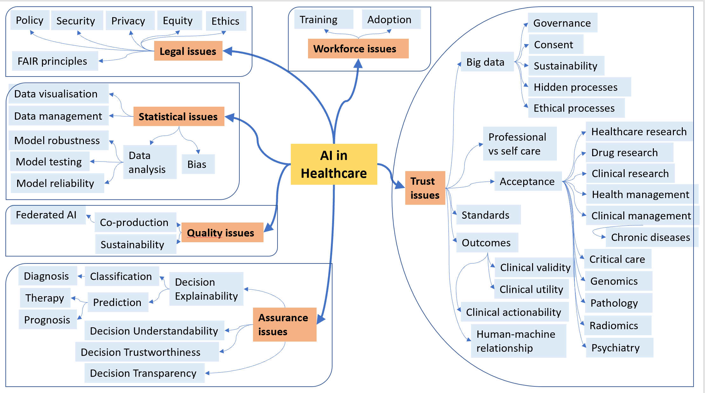

Slide 33
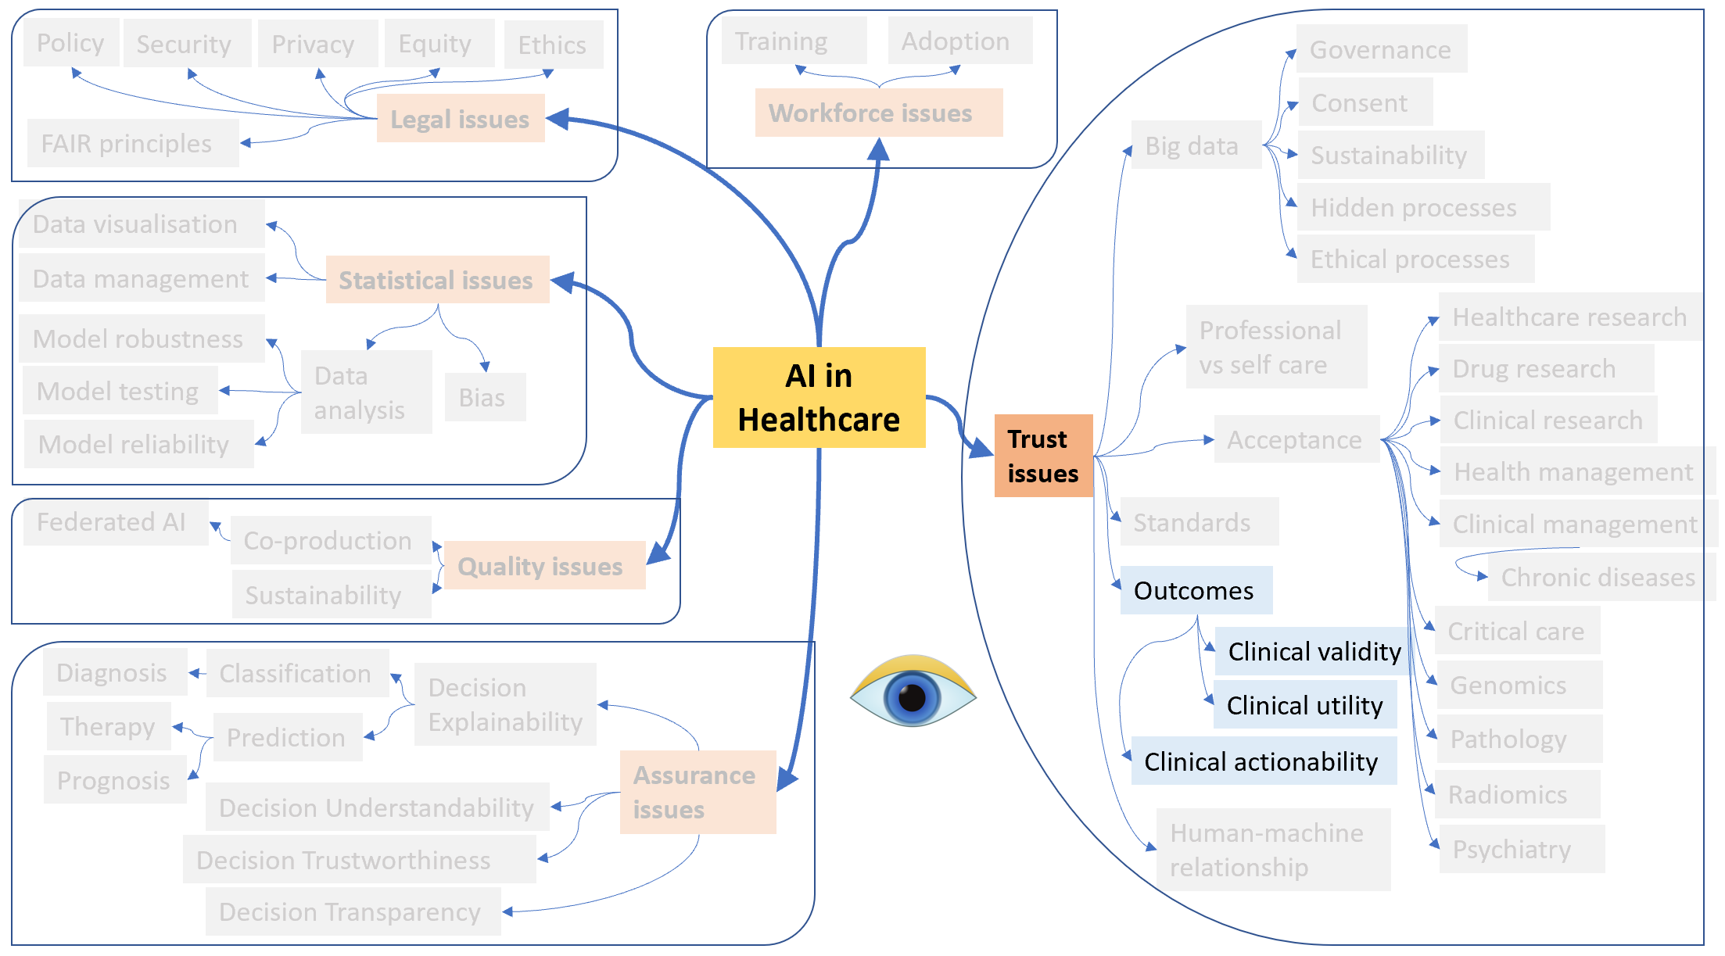

Slide 34
AI in Healthcare
Trust issues
Outcomes
Clinical validity
Clinical utility
Clinical actionability

Slide 35
AI in a Healthcare Application (product, service, system)
Analytic Validity 
Clinical Validity 
Clinical Utility 
Clinical Actionability

Slide 36
Clinical Actionability of AI applications
Actionability includes a broad spectrum of actions that can benefit a person, a family, and society. There is no general agreement on how to define actionability, medical viability, or clinical utility, and documentation of efficacy in advanced areas of medicine, including AI, is often of relatively poor quality compared to evidence in other areas. These factors will lead to substantial changes in access to and reimbursement of diagnostic and care services supported by AI applications. Systematic, standardized, and authoritative assessment of clinical actionability is an important step toward improving population health outcomes.
Adapted, from Goddard KAB et al: Establishing the Medical Actionability of Genomic Variants. Annu Rev Genomics Hum Genet. 2022 Aug 31;23:173-192. doi: 10.1146/annurev-genom-111021-032401

Slide 37
AI-enhanced health care products will be properly reimbursed when and if they:
Prevalence, Incidence, Resource Absorption
relate to Severe Diseases and/or Common Conditions,
with numerous Unmet Needs,
are supported by excellent Efficacy Documentation,
are recommended in the Clinical Guidelines,
while assuring some comparatively better:
Health outcomes of real interest to patients,
Efficacy and Safety/Tolerability of treatments,
Risk reductions and Public Health gains,
Symptom relief,
and generating:
savings in direct health care expenses,
a good level of cost-effectiveness.
Burden of Disease (QALY)
Literature (critical analysis)
International Guidelines
Access, Mortality, BoD, Functions, Disability, QoL
Risk stratification
Literature (critical analysis)
Impact on resource absorption
CUA modeling etc.

Slide 38
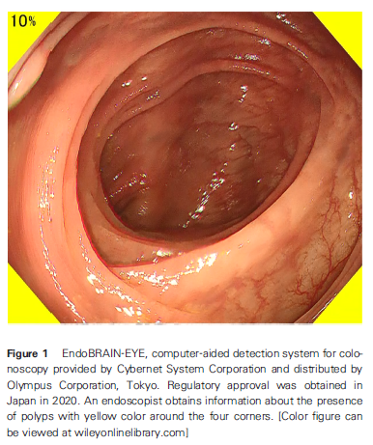
Clinical Actionability of AI applications Promising but not yet assessed cases:
Gastrontestinal Endoscopy
Mori Y, Neumann H, Misawa M, Kudo SE, Bretthauer M. Artificial intelligence in colonoscopy - Now on the market. What's next? J Gastroenterol Hepatol. 2021 Jan;36(1):7-11. doi: 10.1111/jgh.15339. PMID: 33179322.

Slide 39
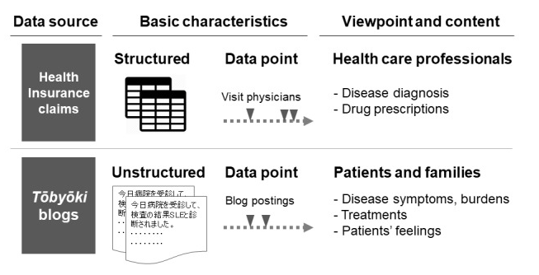
Clinical Actionability of AI applications Promising but not yet assessed cases:
Pharmacovigilance
A classical medical database represents only a part of a patient's entire treatment experience, and analysis using solely such a database cannot represent patient-level symptoms or patient concerns about treatments. This study showed that analysis of tōbyōki blogs can provide added information on patient-level details, advancing patient-centric pharmacovigilance.
Matsuda S, Ohtomo T, Tomizawa S, Miyano Y, Mogi M, Kuriki H, Nakayama T, Watanabe S. Incorporating Unstructured Patient Narratives and Health Insurance Claims Data in Pharmacovigilance: Natural Language Processing Analysis of Patient-Generated Texts About Systemic Lupus Erythematosus. JMIR Public Health Surveill. 2021 Jun 29;7(6):e29238. doi: 10.2196/29238

Slide 40
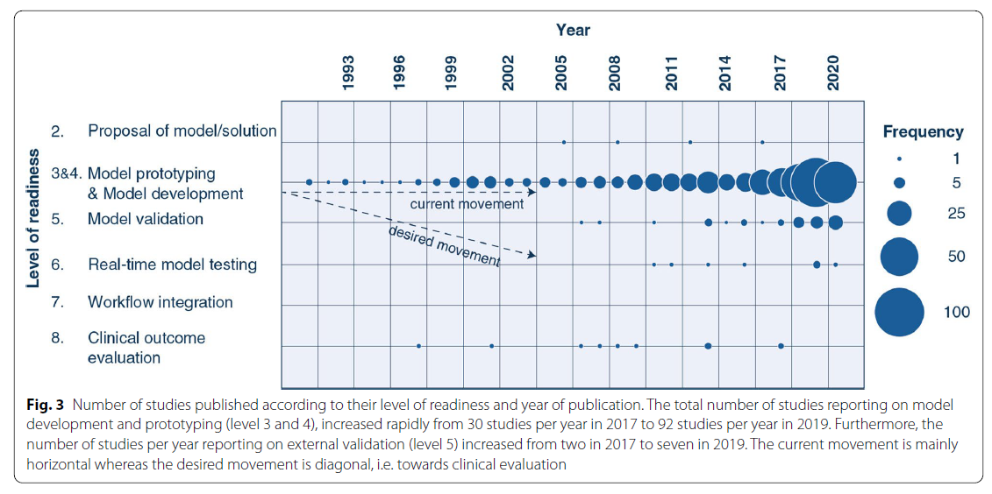
Clinical Actionability of AI applications Promising but not yet assessed cases:
Intensive Care
van de Sande, D., van Genderen, M.E., Huiskens, J. et al. Moving from bytes to bedside: a systematic review on the use of artificial intelligence in the intensive care unit. Intensive Care Med 47, 750–760 (2021). https://doi.org/10.1007/s00134-021-06446-7

Slide 41
Clinical Actionability of AI applications Promising but not yet assessed cases:
Oncology, Clinical Laboratory
Dhiman P, Ma J, Navarro CA, Speich B, Bullock G, Damen JA, Kirtley S, Hooft L, Riley RD, Van Calster B, Moons KGM, Collins GS. Reporting of prognostic clinical prediction models based on machine learning methods in oncology needs to be improved. J Clin Epidemiol. 2021 Oct;138:60-72. doi: 10.1016/j.jclinepi.2021.06.024
Reporting of machine learning-based prediction models in oncology is poor and needs to be improved to allow for further validations and increasing their chance of being used in clinical practice and without causing patient harm.
Specific areas for which reporting needs to be improved include the title and abstract, sample size justification, description of flow and baseline characteristics of participants and the presentation of the full models.
Crowley RJ, Tan YJ, Ioannidis JPA. Empirical assessment of bias in machine learning diagnostic test accuracy studies. J Am Med Inform Assoc. 2020 Jul 1;27(7):1092-1101. doi: 10.1093/jamia/ocaa075
Classically emphasized methodological pitfalls first described in conventional diagnostic tests likely hold true for ML tools as well.

Slide 42
Clinical Actionability of AI applications Promising but not yet assessed cases:
Take Home Messages
Device approval of AI is typically granted with proof of technical validity / accuracy and thus does not intend to directly indicate if AI is beneficial for patient care or if it improves patient outcomes. Neither can it categorically address the issue of limited generalizability of AI.
After achieving device approval, it is up to medical professionals to determine if the approved AI algorithms are beneficial for real-world patient care.
Ultimate clinical validation of AI requires evaluations of its impact on patient outcomes, referred to as clinical utility, and for which randomized clinical trials are ideal.
Insurance coverage decisions generally require a demonstration of clinical utility that the use of AI has improved patient outcomes.
Park SH, Choi J, Byeon JS. Key Principles of Clinical Validation, Device Approval, and Insurance Coverage Decisions of Artificial Intelligence. Korean J Radiol. 2021 Mar;22(3):442-453. doi: 10.3348/kjr.2021.0048

Slide 43
Six (+ one) challenges for AI solutions in healthcare
Before embarking on AI deployments, get the basic digitisation of systems and data in place.
Build the clinical evidence of quality and effectiveness for AI value proposals (no black boxes).
Regulation: possibly at EU level. As a product? As a tool that supports decision making? Medically prescribed? Over-the-counter?
Liability and risk management is a particular challenge.
Reimbursement: mainly at national (even local) level. Clear criteria and funding models will be needed.
Don’t mind about HTA.
7. Humans are social creatures who will need to learn how to stay relevant when AI becomes ubiquitous
Adapted, from: EIT Health, McKinsey &Co: Transforming healthcare with AI - The impact on the workforce and organisations. March 2020

Slide 44
Proposed lectures (downloadable in this class)
Regulatory considerations on artificial intelligence for health. Geneva: World Health Organization; 2023. Licence: CC BY-NC-SA 3.0 IGO
EPRS | European Parliamentary Research Service – June 2023: AI act
News EU Parliament - June 2023: EU AI Act: first regulation on AI
COM(2021) 206 final - Proposal for a REGULATION OF THE EUROPEAN PARLIAMENT AND OF THE COUNCIL LAYING DOWN HARMONISED RULES ON ARTIFICIAL INTELLIGENCE (ARTIFICIAL INTELLIGENCE ACT) AND AMENDING CERTAIN UNION LEGISLATIVE ACTS
COM(2021) 206 final – Annexes
Bill Gates - 21.03.2023: The Age of AI has begun. www.gatesnotes.com
Business Insider - 08.2022: Amazon got in its own way when it tried to take on the healthcare industry.
OECD/European Union (2022), Health at a Glance: Europe 2022: State of Health in the EU Cycle, OECD Publishing, Paris. https://doi.org/10.1787/507433b0-en.

Slide 45
Transforming healthcare
Michele Tringali
Ministero della Salute
Direzione Generale della Programmazione sanitaria – Roma, Italia
m.tringali@sanita.it
Presented herein are the author’s opinions. No implied endorsement may be expected by Ministry of Health, Italy.

