Slide 1
Introduction to the Biodesign Process & HealthTech innovation
Dr Bharadwaj Chada

Slide 2
Overview of the session
Introduction
Overview of the Biodesign Process
Team activity
Pitches
Q&A

Slide 3
About me
GP Trainee/Family Medicine Resident, North West London
Honorary fellow, Brunel Medical School
HealthTech and Innovation Fellow, Harvard Medical School (2022 – 23)
Clinical Lead, AI Strategy and Digital Clinical Safety teams, NHS England (2021 – 22)
Academic Foundation Doctor, University Hospitals of Leicester NHS Trust (2019 – 21)
Homerton College, University of Cambridge, MSt in Healthcare Data: Informatics, Innovation and Commercialisation
King’s College, London, MBBS (2019)
King’s College, London, Healthcare Management BSc (2016)

Slide 4
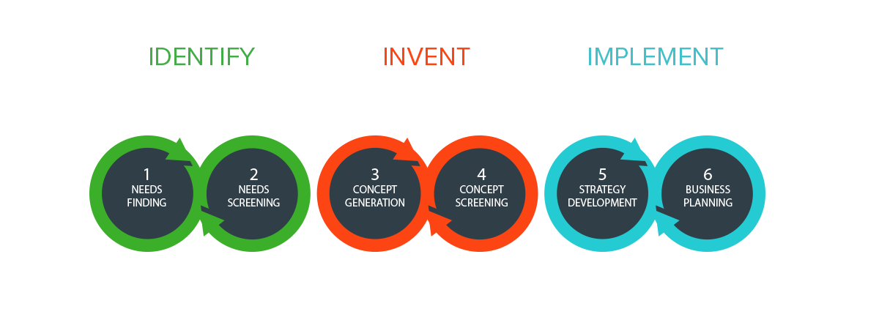
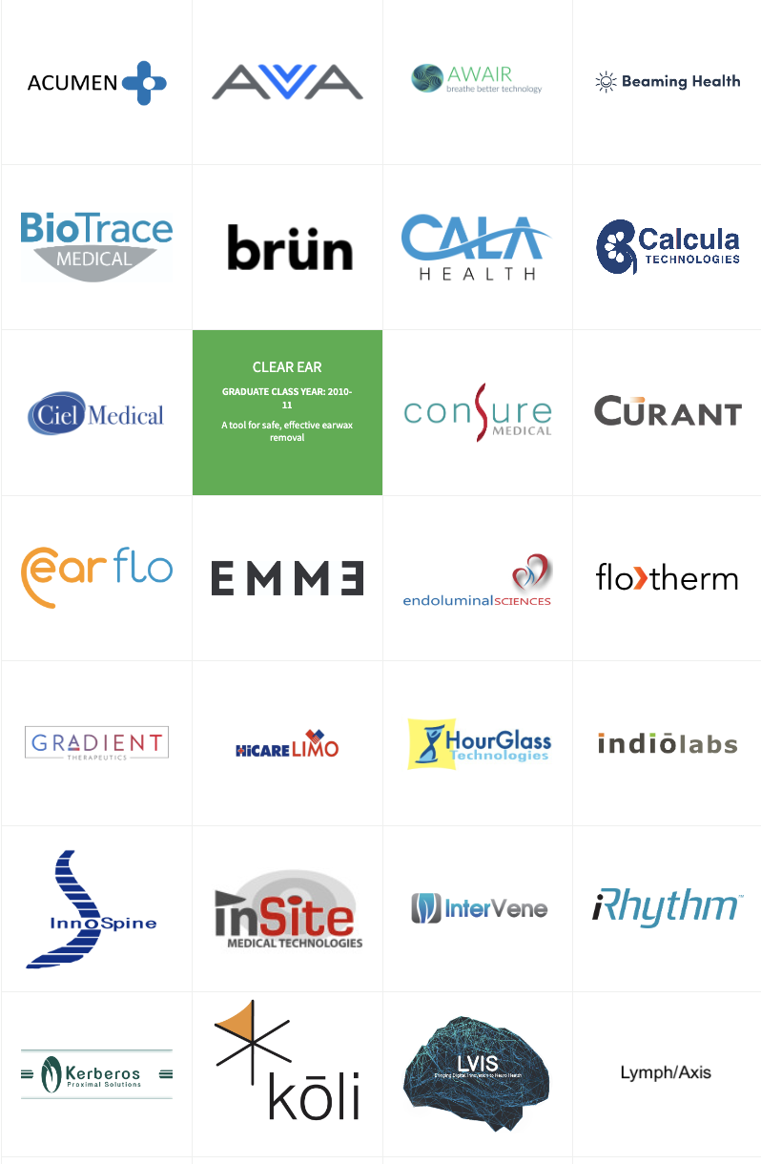
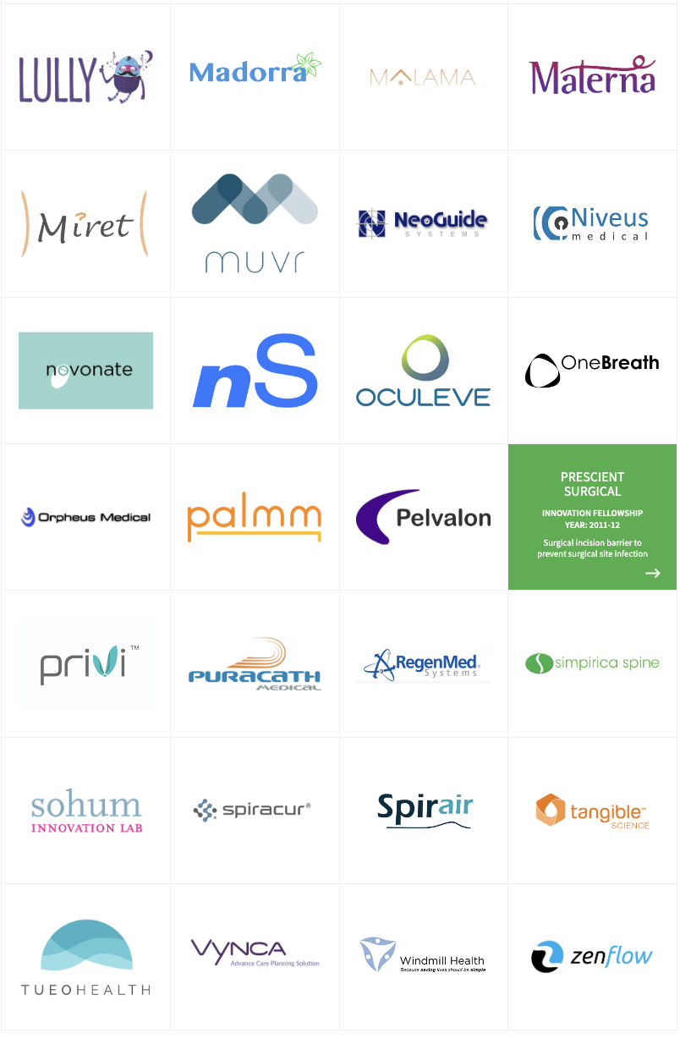
Overview of the Biodesign Process
Notes:
The Biodesign process was first developed at Stanford University in California back in 2000 by Paul Yock and Josh Makower, both of whom were dual trained as medical doctors and engineers. The decision to develop this process was borne from the belief that innovation is a skill that can be learned, practiced, and perfected.
Yock and Makower launched the Stanford Biodesign program the following year, in 2001, which is a year-long fellowship that brings together a multidisciplinary team comprising doctors, engineers, academics, as well as people with business and commercial backgrounds, in order to identify areas of unmet and bring to market potentially lifechanging solutions.
In the 20 years since, the program has seen the launch of over 50 companies, helped over 9.45 million patients, and has led to the development of several similar programmes around the world, including in India, Singapore, Japan, Spain, and my own program – the Harvard HealthTech Innovation Fellowship at Harvard Medical School.
At the heart of the Biodesign process are three key phases: Identify, Invent, and Implement. And underpinning each of the phases are a series of essential stages: Needs Finding and Needs Screening during the Identify phase; Concept Generation and Concept Screening during the Invent phase; and Strategy Development and Business Planning during the Implement phase.

Slide 5
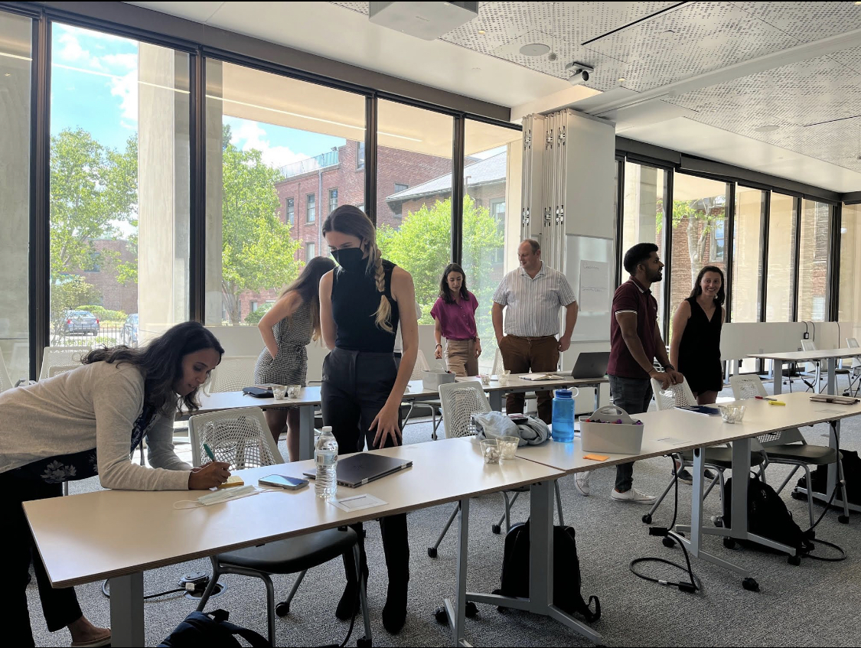
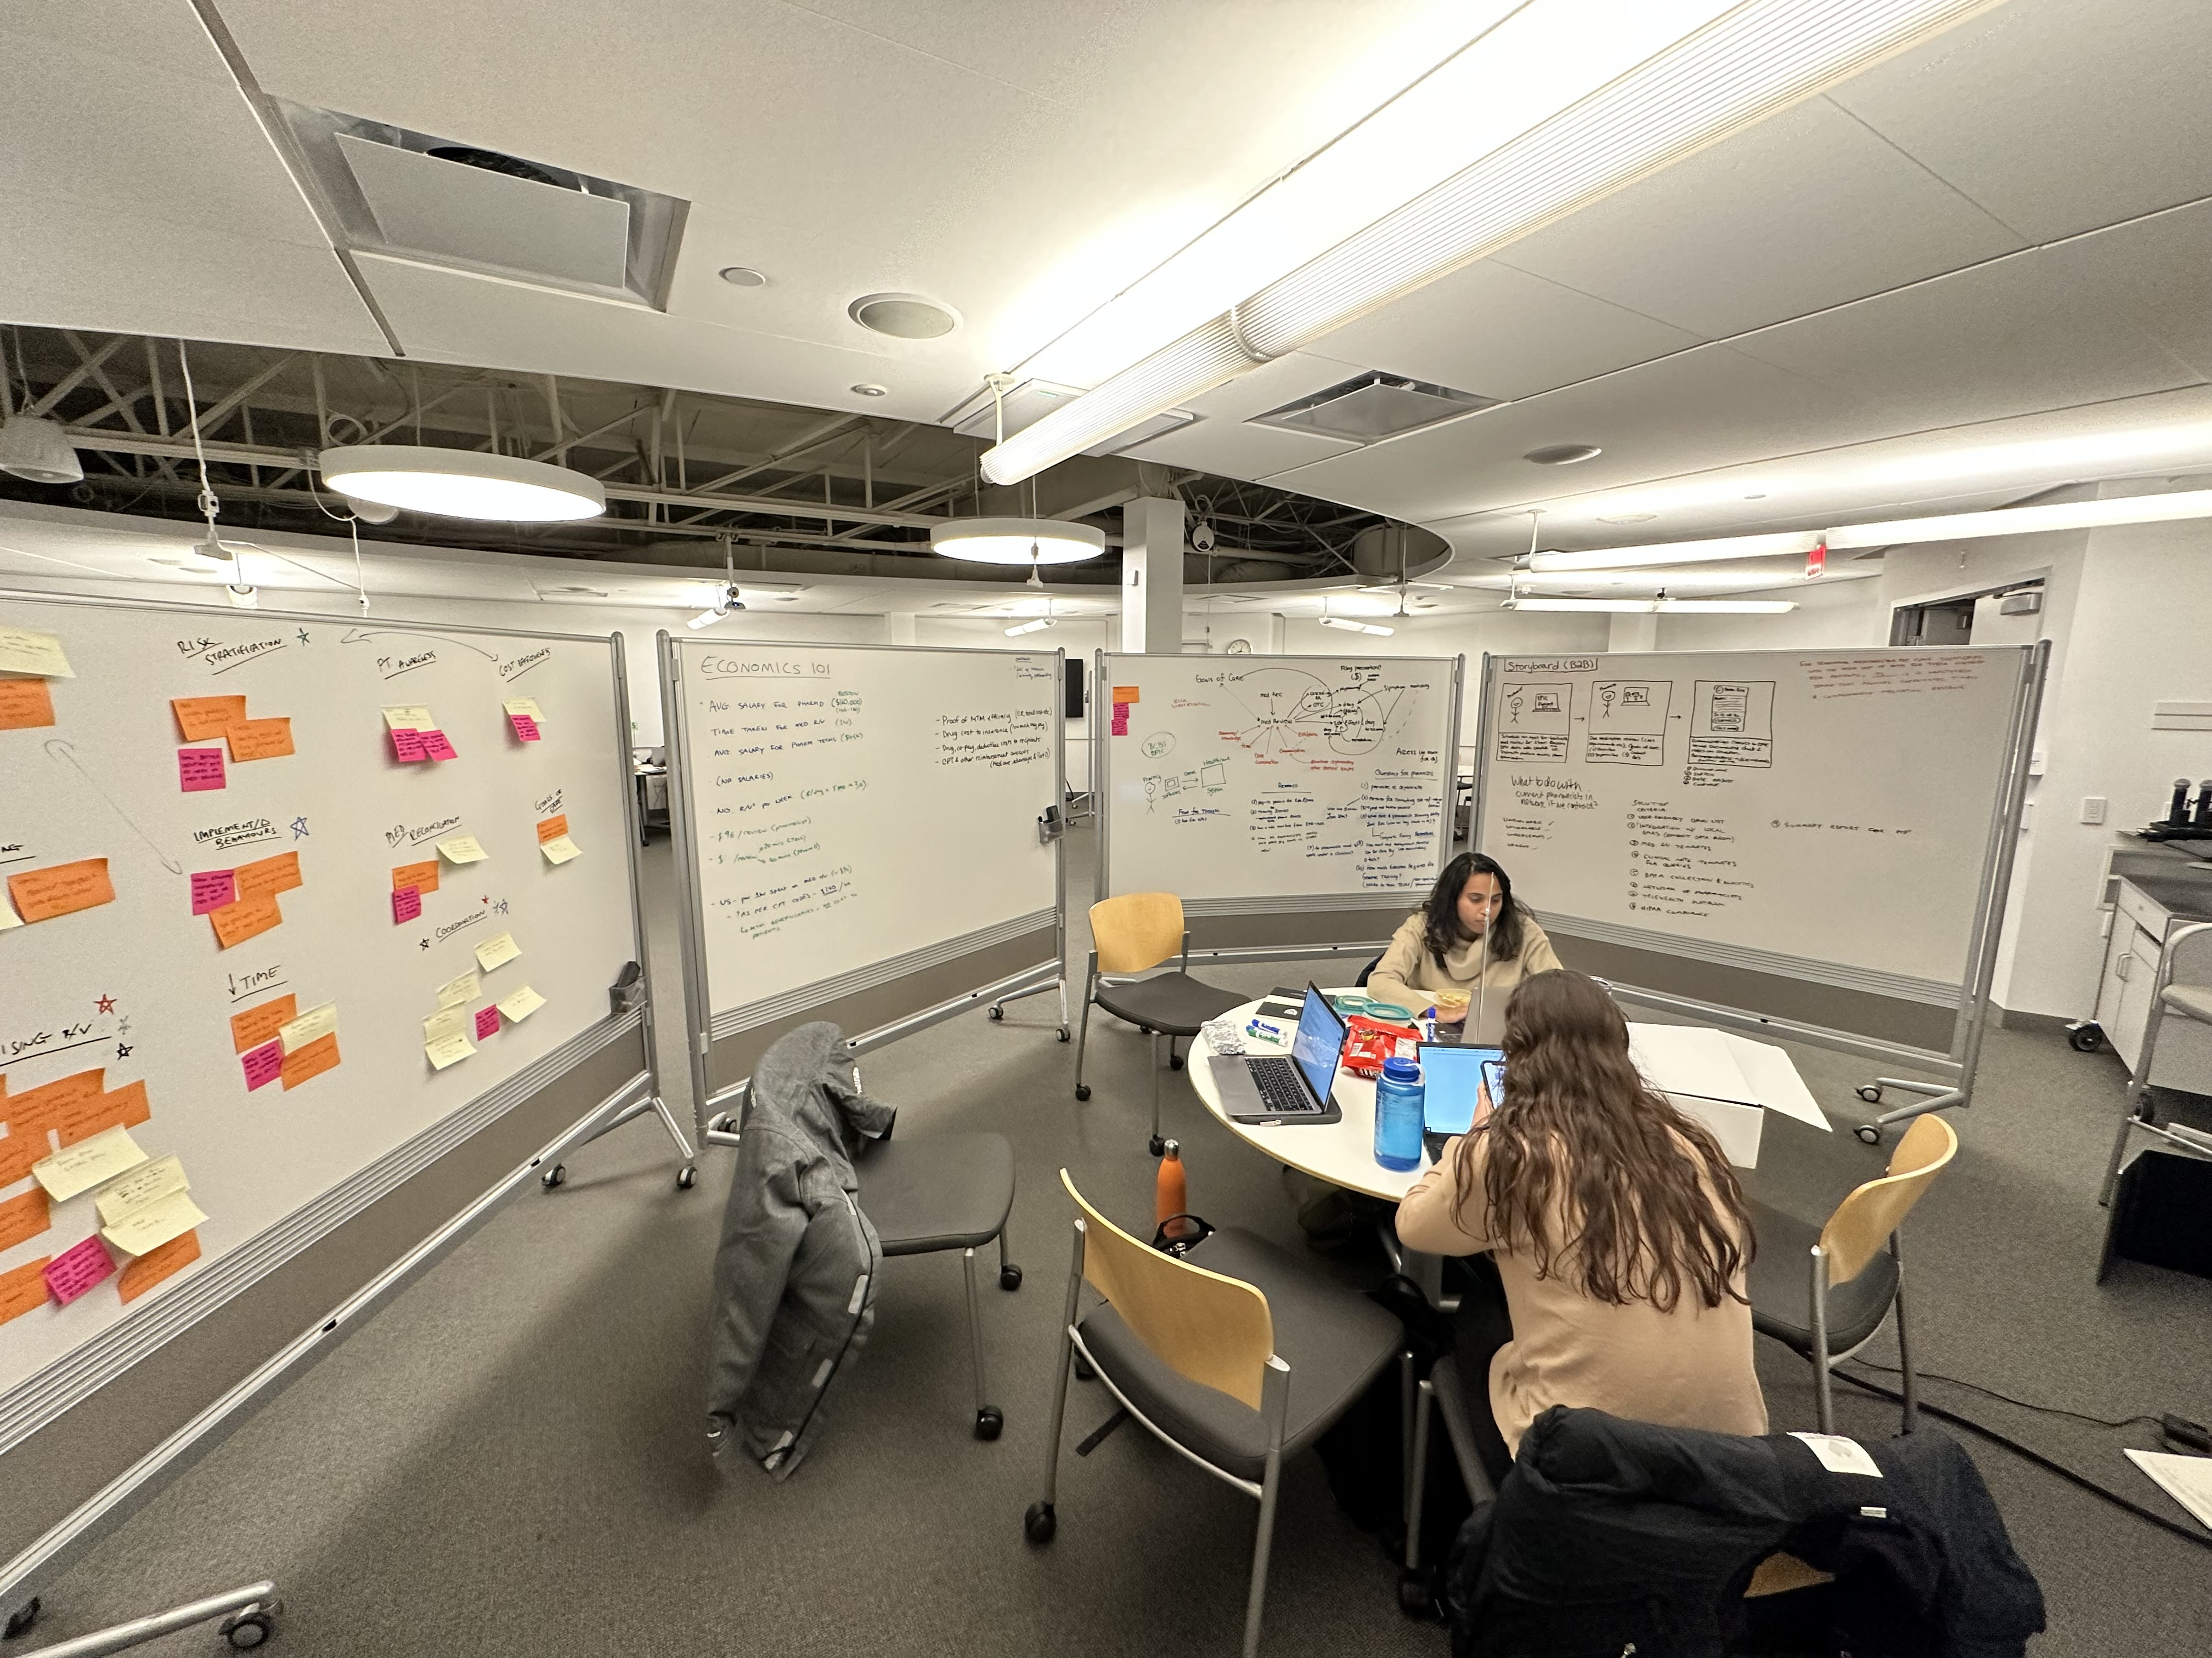
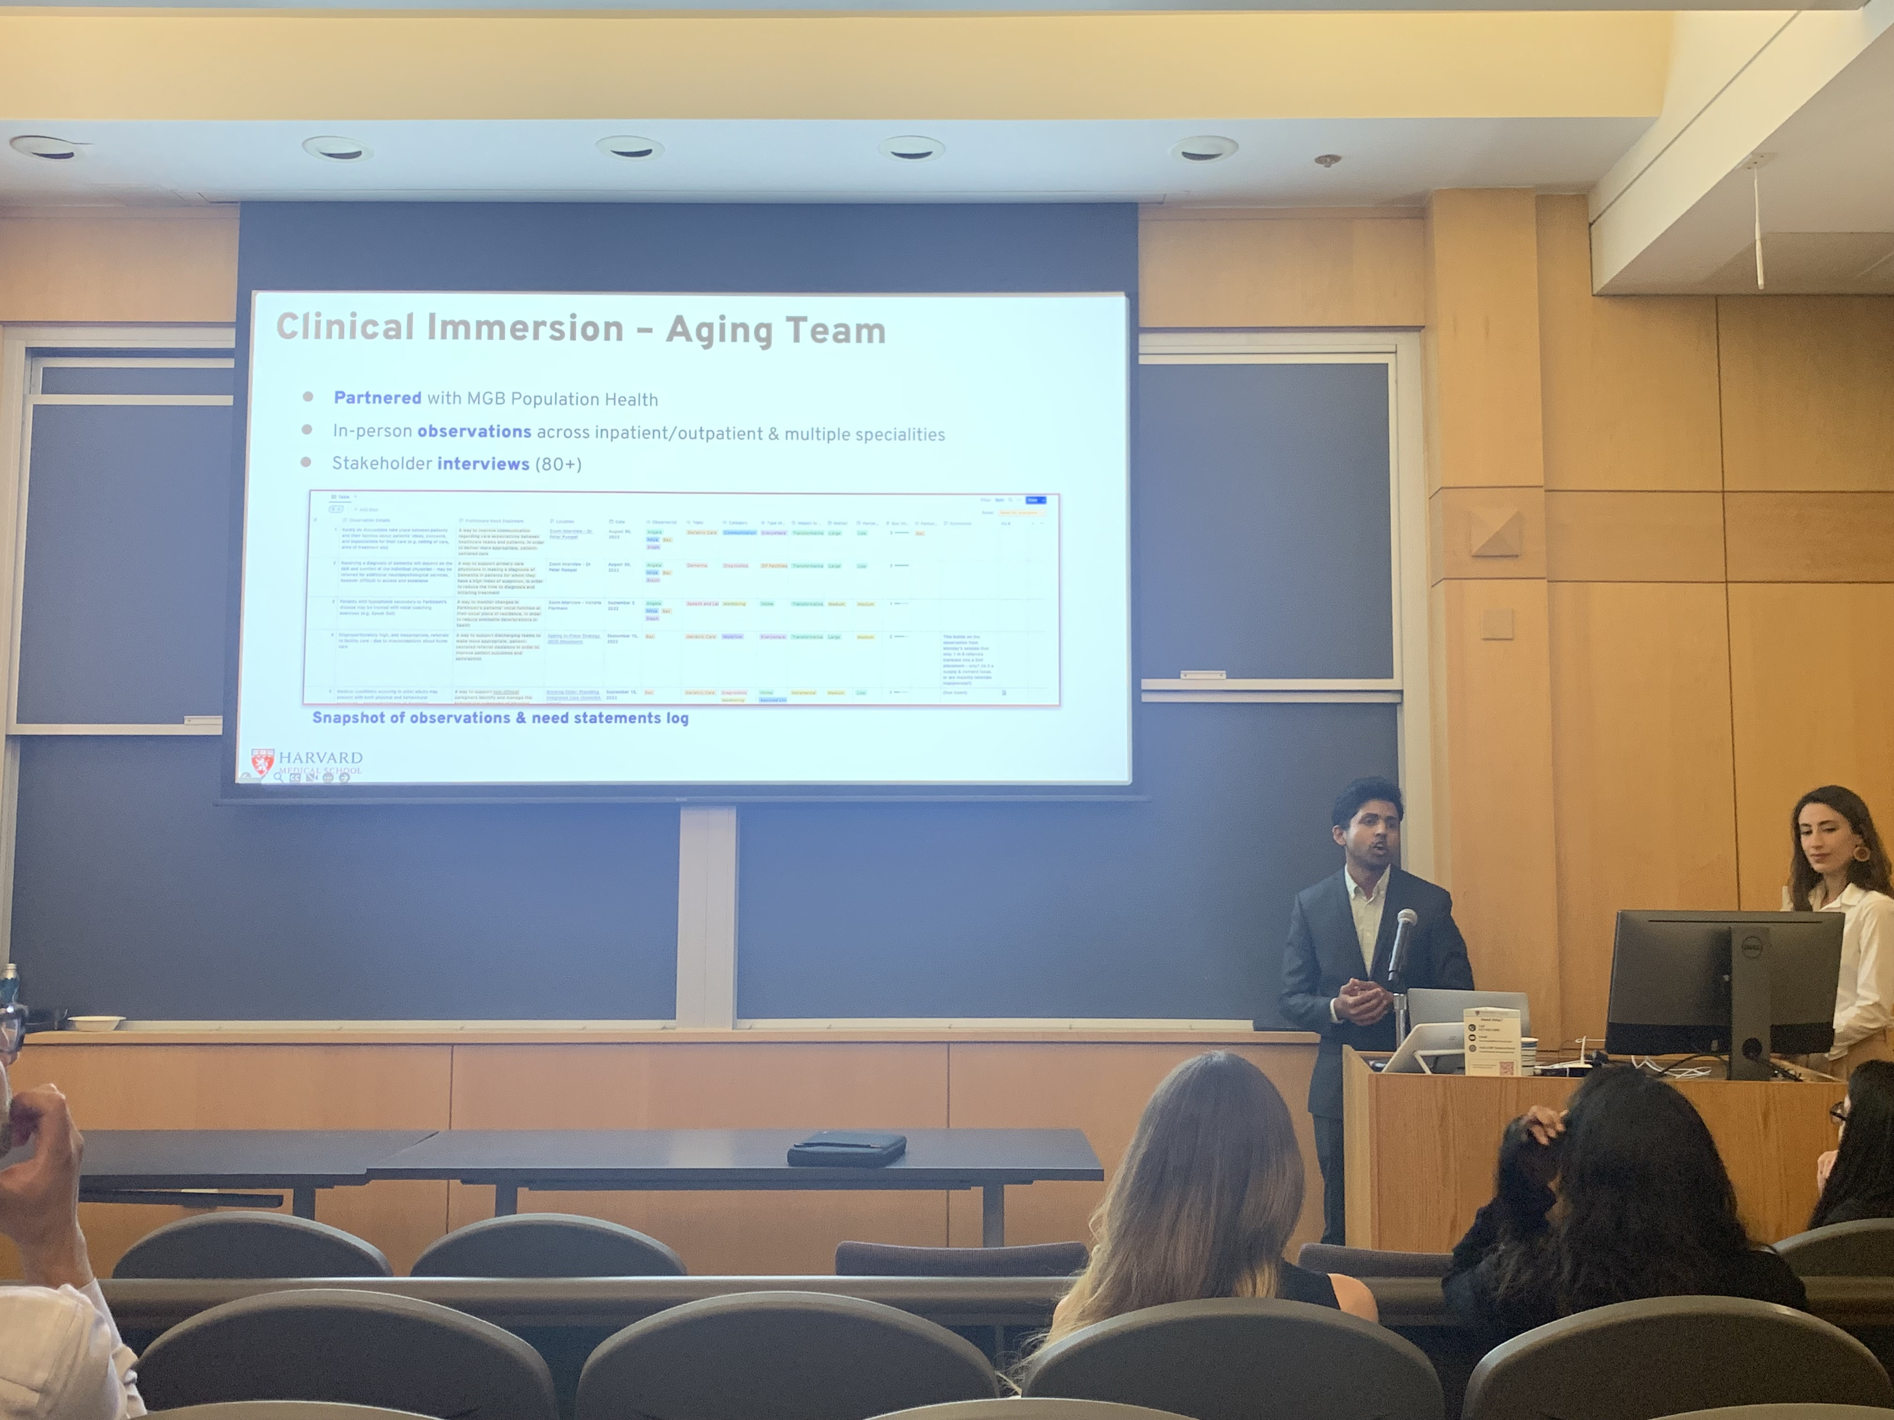
Harvard HealthTech Fellowship

Slide 6
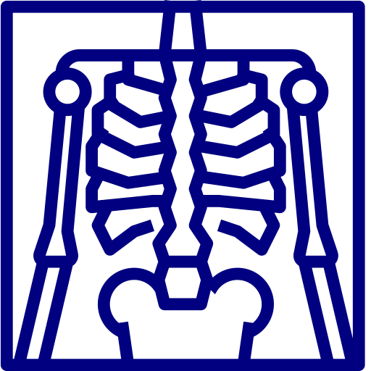
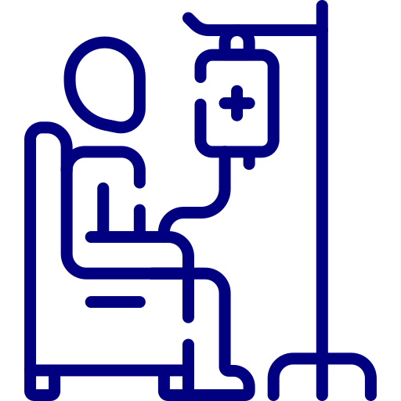
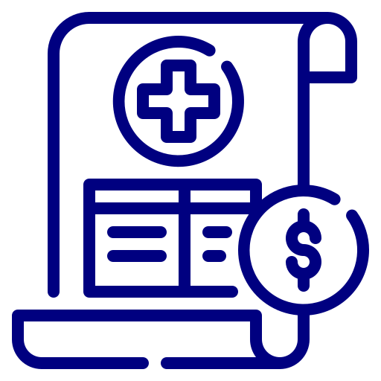
Identify
Invent
Implement
Need finding
Need screening
Notes:
The Identify phase is, in many ways, the key step in this entire process, and refers to truly identifying areas of unmet need. Too often in healthcare, we see solutions in need of problems, inventors that have developed a new technology that they try to ‘retrofit’ onto a problem that maybe doesn’t exist – or does, but isn’t a high enough priority for anyone.
Thus, in this Identify phase, it’s important to closely observe first-hand the current standard of care, and see where the pain points lie. Who are the stakeholders involved? How are they affected by what’s happening in the status quo? Where is the potential to do something better, cheaper, faster, safer? Across the entire care pathway, perhaps from when a patient first notices a nagging cough, to being worked up for lung cancer, to receiving surgery and chemotherapy, to post-op recovery and rehab, even to the patient’s healthcare provider billing the insurer for the services they’ve provided, where are there bottlenecks and challenges present?
It is these direct observations and stakeholder interviews that will form the basis for subsequently developing needs statements, which is the cornerstone of the Biodesign process, and will be covered in more detail in the next session.

Slide 7
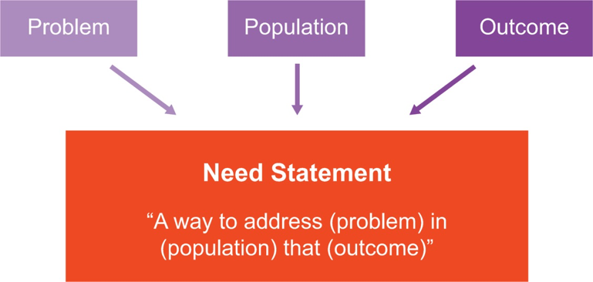
Need Finding
Identify
Invent
Implement
What is the value proposition? (and for whom?)
Derived from observations and stakeholder interviews – one observation → several need statements!
Be specific; think outside of current practice; challenge the status quo; don’t jump ahead to the solution
Notes:
As we described in the previous session, a needs statement is the cornerstone of the Biodesign process, and describes the problem we’re attempting to solve, the population that are affected by this problem, and what the outcome or success metrics you’re targeting are.
Remember though, the challenge is made complicated in healthcare by the fact that the group you’re treating, such as patients, are often different to the people buying your product, which are usually health systems and insurers. Therefore, it’s important that outcomes such as improving quality of life or wellbeing, whilst noble, also need to be rooted in a tangible value proposition and business case for the group you’re selling to.
Can you demonstrate that improved quality of life for your patient group can also materially contribute to cost savings or revenue generation for that patient’s insurer? Keep asking yourself ‘so what’ when drafting the outcomes in your need statements, to really get to the heart of why this problem matters for both your customer and your user.
It may be helpful to consider a thought experiment of what a potential clinical trial or return on investment analysis for your eventual product might look like, and what the key end points might be. For example, if you’re attempting to address the problem of older adults being on too many medications, what are the downstream material benefits of doing so? Could it lead to fewer attendances to the Emergency Room, or shorter hospital stays? How much money could this save for the provider or insurer you’re selling to?
Needs statements are derived from the many observations and stakeholder interviews conducted during the observation phase, and it may be possible that the same observation could give rise to several different and unique needs statements, each varying in the specific problem, population, and outcome you’re targeting.
Importantly, the process of writing a needs statement is iterative and will change with further research. For example, it may be the fact that with further research and expert interviews, you learn that delayed diagnosis is particularly a problem for people in rural communities compared to larger cities, and so you could amend your population to reflect this.
With regards to the outcome here, ask yourself, “so what?”. Why does it matter that the time to diagnosis is reduced? Why would the insurance companies or healthcare providers I sell to care about this? How can I demonstrate meaningful value to them? This is an important, but often very frustrating part of the process, in which intuitively admirable and aspirational targets need to be grounded in a real-world business case.
Some key tips when drafting need statements include trying to be specific in describing your problem, population, and outcome (which is something that will come with a better understanding of the problem space), allowing yourself to think outside of current practice and challenge the status quo, and refraining from jumping ahead to solutioning.
For example, you may be tempted to suggest that an outcome is reducing the time doctors take to conduct current tests. However, implicit in that is the assumption that current screening tests are the gold-standard. Whilst this well be the case, try to give yourself the latitude to think outside of current practice for your need statements.
Similarly, you may think about describing the need as a, “a way to use ChatGPT to improve current tests”. Again, although using ChatGPT could be the direction you eventually choose to take, avoid jumping too far ahead in your need statement, and focus only on defining the problem, population, and outcome.
It's worthwhile recording your observations in a journal, and tagging them by date, location, and who else may have been present with you in the room. And then you might want to maintain a separate spreadsheet or database with a running list of your needs statements, with separate columns as you continually refine them. It’s always interesting to review how you may have iterated or pivoted your needs statements over time, as new information emerges with further research.

Slide 8
Need Screening
Identify
Invent
Implement
Epidemiology and Scope
Problem prevalence
Impact to patient
Problem understanding
Existing Solutions
# of existing solutions
Success of existing solutions
Stakeholder Analysis
Stakeholder concern
Access for target user
Switching costs
Market Analysis
TAM
Growing/shrinking market
Market trends
Regulatory and Reimbursement
Medical device
Intellectual property
Customers
Notes:
The challenge then becomes screening this big list of needs until you eventually arrive at a few top needs that you’re enthusiastic about taking forward. This is often the least exciting part of the process, and requires the most mental drudgery, but it is very important that it is done well to ensure that you’re innovating in a space that is an interesting, high-impact, and lucrative opportunity.
Needs screening is a combination of subjective judgement calls, and more objective in-depth research. A first pass cull could be something as simple as ‘how much do I actually care about this need?’, ranked on a 3-point Likert scale. Many of the most successful digital health innovations are helmed by founders that are single-mindedly mission driven, so if you’re not passionate about the space you’re working in, you should think twice before pursuing it, irrespective of how large the market is.
Of course, it’s also true that your interest in something could evolve with time, such that something you initially weren’t drawn to at all, later becomes something you’re incredibly enthusiastic about. So rather than deleting the needs that don’t pass the ‘gut check’, you may want to consider hiding them or removing them from view, but still have access to them if anything changes.
You should then attempt to rank the remaining needs using a series of pre-determined filters. Typically, these could be filters such as: the epidemiology and scope of the problem; existing solutions already out there; stakeholder analysis; market analysis; and regulatory and reimbursement.
You might then want break each of these filters down into sub-filters, with questions that you’ll need to answer during the course of your research. For example, the epidemiology and scope filter could be broken down further into the problem prevalence, the impact to the patient, and how well understood the problem space is.
Likewise, stakeholder analysis may encompass how much of a concern this problem is for key stakeholders, how easy or difficult it may be for your target user to access your solution, and how likely they are to switch from their current practices.
Market analysis, on the other hand, could refer to the size of the total market, whether the market is growing in size, and any encouraging or promising trends in the market.
Regulatory and reimbursement is particularly key in the context of digital health, which we’ll cover more in the following sections. For the purposes of needs screening, you may wish to consider whether your tool is likely to be a medical device (and if so, the class of medical device), whether there are elements of your intellectual property that will need to be protectable, and who you might expect to sell to, and how you might get paid. Importantly, in the context of US healthcare and the shift towards Value Based Care (VBC) agenda, you may also want to pre-empt whether your solution is in keeping with the VBC agenda for insurers.
It's worth maintaining a separate worksheet with the filters, subfilters, and key questions, in order to document your research. The research can then be used to inform the scores for each of these criteria, again on something like a Likert scale.
Of course, it’s true that not all the filters and subfilters should be weighted equally, since some are more important than others, and some that are better understood than others – it may feel arbitrary to adjudge one of these subfilters as a 3/5 on the basis of limited information. There’s no escaping that even these attempts to be objective will inherently contain some element of subjectivity, and the challenge lies in trying to be as objective as possible.
It's important therefore that the filters are reviewed and consensus reached on their relative importance. For example, it may be the case that epidemiology and market analysis are considered to be the two most important criteria, and are weighted accordingly. On the other hand, stakeholder analysis for a given need statement may be poorly understood or thought to be less important, and therefore weighted down to reflect this.
You can then aggregate the scores for a given need to arrive at a total, which can be used to shortlist your needs. The remaining needs can then be put through the mill again, each time with increasing rigour and comprehensiveness, to eventually arrive at your final list of top needs.

Slide 9
Concept Criteria
Identify
Invent
Implement
Concept Generation
Concept Screening
Efficacy
Safety
Must Have
Cost
Nice to Have
Usability
Access
Notes:
We return now to the Biodesign process, as move now to the invent phase of the process. If you recall, this follows the identify phase, in which we’ve both found and subsequently screened our needs, as now prepare to brainstorm and prototype potential solutions for our top need.
Before we can start with the concept generation though, we need to define the criteria that any eventual solution must meet, known as our concept criteria. Concept criteria are helpful guidelines or parameters to inform our concept generation, and can be defined across a range of domains, although the most common are safety, usability, effectiveness, cost, and access. Typically, criteria are further divided between ‘must-have’ criteria, which are – as the name suggests – non-negotiable and essential for the stakeholders involved to address the need, and ‘nice-to-have’, which are more ambitious targets or ‘bonus points’ to work towards.
Concept criteria are usually informed by a combination of your own principles as a founding team, secondary research, literature reviews, and an analysis of the competition, and by speaking with end-users, other stakeholders involved, and Key Opinion Leaders (KOLs).
Efficacy criteria are key, and relate to the clinical or other outcomes your digital health tool should achieve. For example, if your outcome is a reduced time to diagnosis, well, how much do you want to bring this time down by? What’s the current standard of care, and what should be your indicator of success?
Safety is also a very important criteria, particularly in healthcare, and relates to an acceptable or allowable rate of complications or adverse events associated with the use of your product. Generally, you would hope your solution is safe 100% of the time, but sometimes complications may arise. If you’re developing a new clinical decision support tool that aims to diagnose skin cancer using biopsy images, how often might the tool miss a diagnosis, known as a false negative. What’s an acceptable rate here?
Cost, meanwhile, refers to the threshold that cannot be exceeded from the perspective of your potential customers, and would be informed by how much they’re currently paying or are willing to pay. For example, your research may have indicated that customers are willing to pay as much as $100 a month for something that helps put their child to sleep at night, and perhaps even up to $150 if it’s easy to use and highly effective. Your must-have cost criteria, then, would be a tool that’s less than $150, whilst your nice-to-have criteria would be something that’s less than $100.
Usability criteria are in relation to the complexity, skill level, and training requirements for users to use your tool, and how it fits within current workflows or practices. Perhaps a must-have criteria might be something that the patient’s primary care physician can incorporate within their current workflow and doesn’t add to the amount of time they end up spending with the patient. A nice-to-have on the other hand, could be something that patients and their caregivers can use themselves without needing to visit the PCP.
And finally, access criteria relate to whether all populations and demographics are able to receive benefit from your solution, and making sure certain groups aren’t marginalised by it. In the skin cancer detection example, will it be equally as effective in people with darker skin tones?

Slide 10
Concept Generation
Identify
Invent
Implement
‘Amp up the good’
‘Remove the bad’
How Might We?
‘Question assumptions’
‘ID unexpected resources’
Be specific
Be aspirational
Prioritise quantity over quality
Range of selection criteria
‘Create an analogy’
Notes:
Concept generation is often the most enjoyable part of the Biodesign process, and may come as a welcome injection of creativity and lateral thinking after the drudgery that was needs screening process. The idea is that concepts are best generated during structured brainstorm sessions, in which small teams get together and rapidly come up with a huge volume of ideas, that are then narrowed down or winnowed.
One of the most popular brainstorming techniques to help guide concept generation is known as ‘how might we’, which essentially involves posing a series of questions to help get at the heart your need statement. How, assumes that there exists a solution that’s waiting to be found, Might implies that there’s no right answer and any suggestion is just one in a sea of possibilities, and We emphasises the collaborative nature of this process.
The process of writing How Might We questions can feel a little abstract at first, but it might be possible to frame your questions in several ways to make it a little easier. For example, you might want to ‘amp up the good’, and make the status quo more enjoyable and fun. Conversely, you could ‘remove the bad’, and think about how to make current practices less time-consuming or boring. You could ‘question assumptions’, to see whether there’s the potential to redesign or flip certain elements of the current workflow on their head. And you could ‘identify unexpected resources’ that might help to address the problem you’re tackling, or ‘create an analogy’ and draw parallels with other experiences, such as ordering an Uber or going to the Spa.
How might we questions are best when you tap into specific insights or needs you’ve uncovered, and feel free to be extremely aspirational and shoot for the moon. The tendency is to be cautious or guarded in writing these questions and not stray too far from current practices – this is really an opportunity to explore paradigm shifts in the way things are done.
Try to be specific in your choice of outcomes – for example if you’re hoping to make a process easier, do you really mean faster, or involving less paperwork? And think about other resources you could potentially leverage. If something has traditionally been the remit of a certain medical team, does that necessarily have to be the case? Is there some aspect of this process that can be carried out by other healthcare professionals, out in the community, by caregivers, or by the patients themselves?
How might we questions are then the starting point for exploring potential concepts that answer the question, and in turn, your need. For example, the need you’ve identified could be the fact that older adults with mobility issues find it hard to shop for mobility aids. You might have then created an analogy with your how might we question to ask, “how might we make buying mobility aids more like ordering from amazon?”. In turn, an idea for a potential concept might be, “create a star rating system for the quality of the mobility aid”. Importantly, this is your chance to prioritise quality over quantity, and really get down as many ideas as you can in a short space of time.
You and the others in your brainstorm can then vote for the ideas they like the most, which can be across a range of parameters, such as how much an idea resonates with you personally, how attractive it’ll likely to be users, whether you think this is something you and your team can build, and how lucrative the market and opportunity appears to be. One way to vote is for you and your team to put stickers on the ideas. You could use one colour for an idea that’s simple or low-hanging fruit, one for something that’s potentially transformational, and another for something that users are most likely to appreciate. Ideas with the most stickers may then be the ones that you choose to shortlist and work up further.
In this session, we went through the process of concept generation using a popular design thinking tool, asking “How might we?” questions. We’ve also seen how by asking these questions, we can start to ideate the seedlings of our eventual solutions. At this point, why not revisit the cognitive decline need statement and attempt to work up some ‘how might we’ questions and ideas of your own!
Next time, we’ll move onto discussing how we might develop a prototype for our digital health tool!

Slide 11
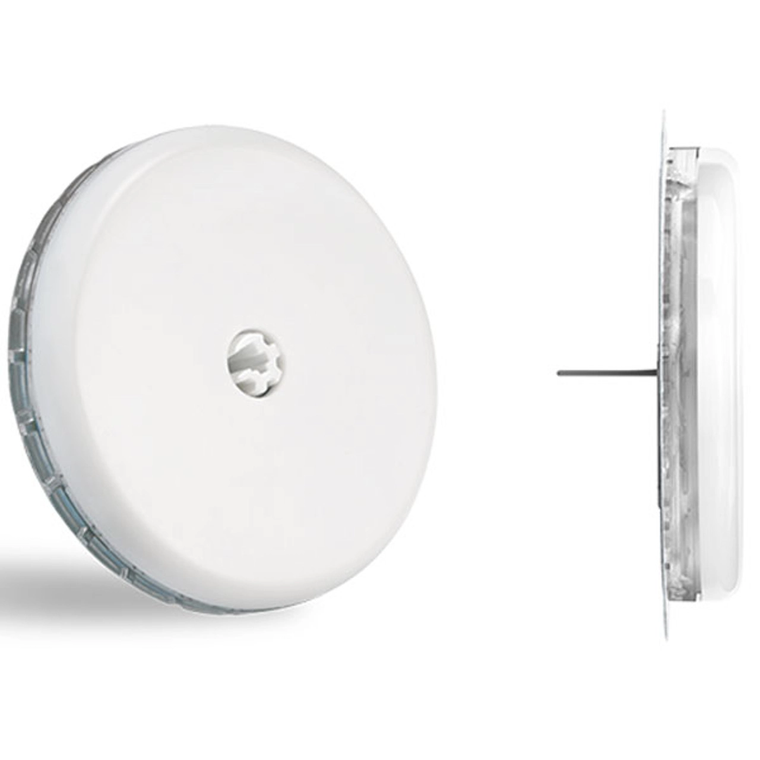
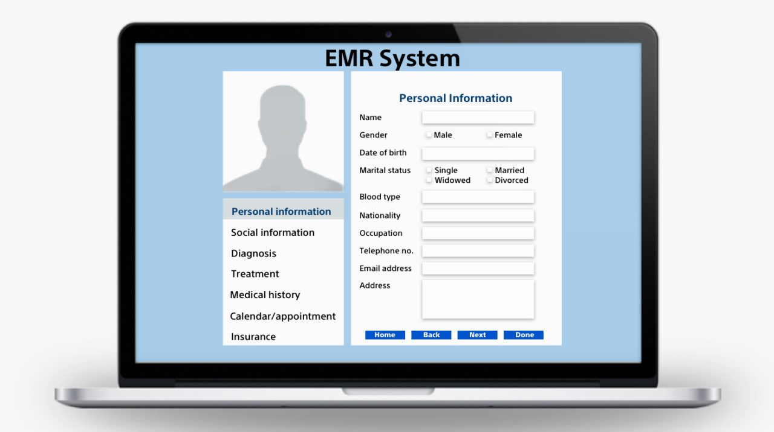
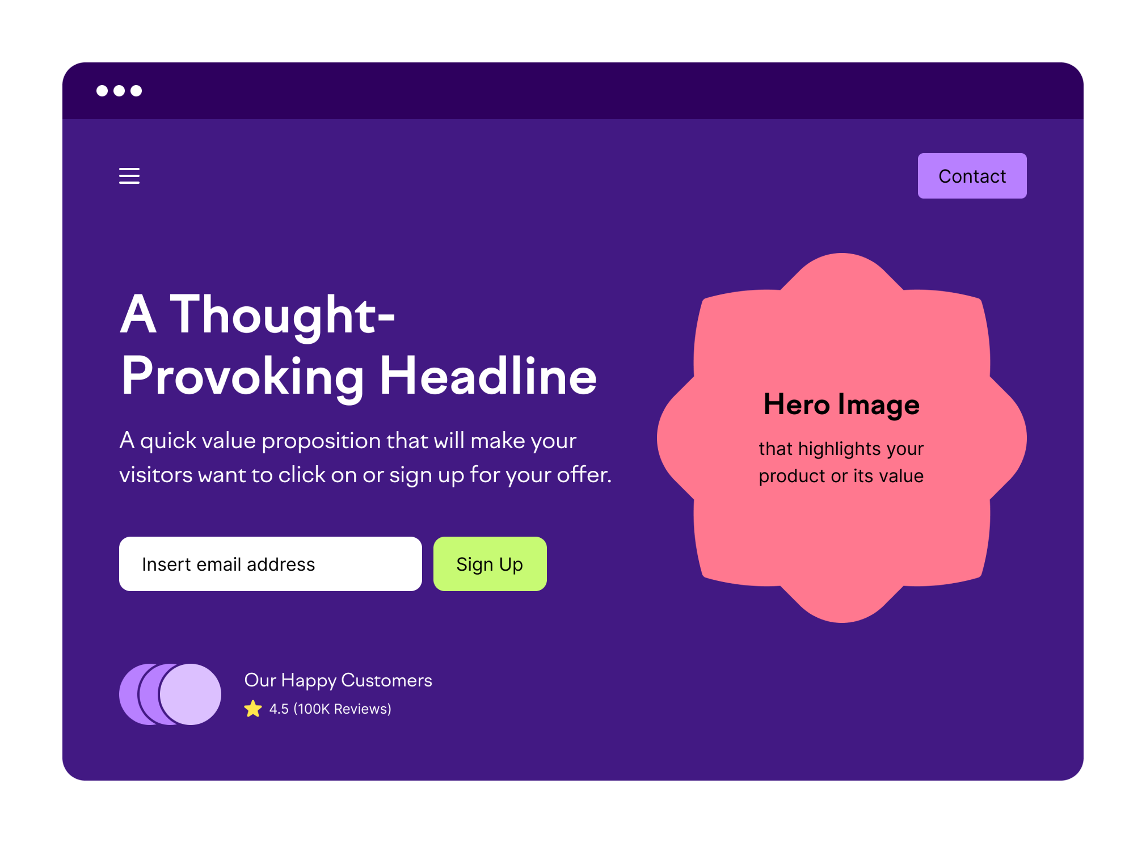
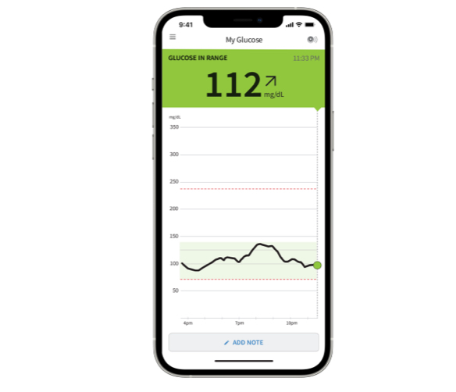
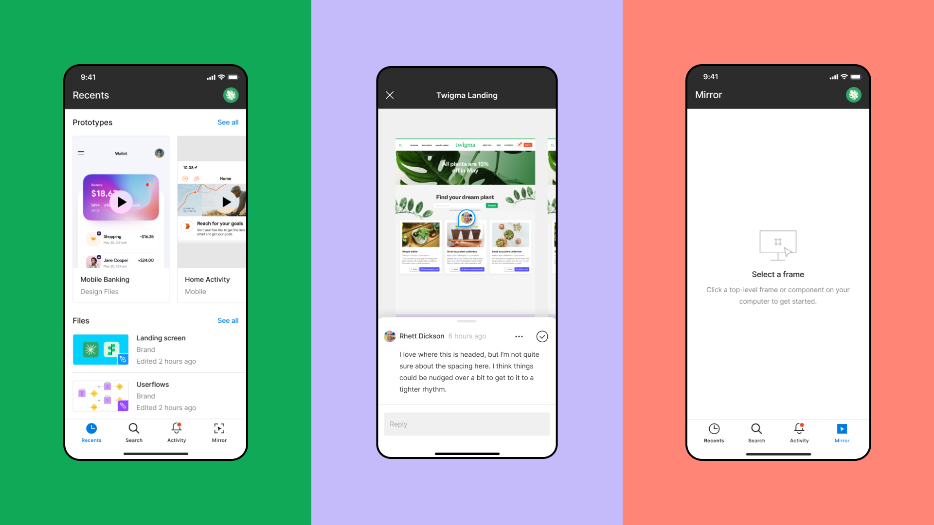
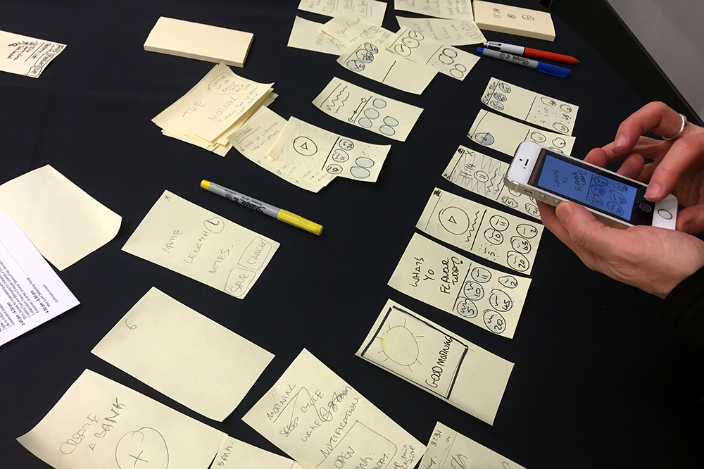
Prototyping
Identify
Invent
Implement
Notes:
In this session, we’ll be talking about prototyping your digital health tool. We’ll be covering what prototypes are and the purpose they serve, different types of prototypes, and how you might go about designing your own prototype.
Remember, we’re talking here about digital health products, which are typically some form of software or mobile application, which is what we’ll cover in this session. Software prototypes are typically represented by drawings on a page, or using development tools to wireframe or mock up what your user interface is going to look like. Hardware prototypes, on the other hand, are physical representations of the intended product, and made using materials such as plastic and metal.
However, it’s also true that digital health tools may have some hardware component to them, such as a smart pill dispenser or remote monitoring device. Therefore, it’s worth familiarising yourself with the basics of hardware prototyping too, for example using computer-aided design tools.
Prototypes are a great way to test and validate your product, as you iterate through lots of different designs and receive feedback from end users and other stakeholders. At the simplest level, it can be little more than a series of post-it notes that are intended to simulate the application, as you show testers a different ‘screen’ depending on the ‘button’ they’ve pressed. Prototypes allow you to validate your design, usability, and functionality before launching to full scale product development. They also help you to identify potential issues or complications with the user experience and journey, that may not have been identified from talking about it in the abstract.
Post-it notes and paper drawings are great to quickly get feedback on early stage ideas, and are what are known as ‘low-fidelity’ prototypes. As you progress with your innovation, you might also want to demonstrate ‘medium’ and ‘high’ fidelity prototypes, for example using tools such as Figma and UXPin, that help to better validate the usability, functionality, and – ultimately –final design.
These tools can help you to produce wireframes, which are visual representation of a web page, screen, or other user interface, and allows users to see the overall layout and appearance of your platform. Even within wireframes, your demo can range from a simple black and white mock-up with little more than lines and text, towards more complex designs with color, branding, and graphic design.
In the context of digital health, you might have some aspect of your solution that interfaces directly with the patient or caregiver, and another that the physician or patients’ healthcare team has access to. There might also be some hardware component, such as a wearable device. It’s important to prototype the different touch points of your product from the perspectives of the different end users.
For example, if your tool is a remote glucose monitoring device that patients can use to track their blood sugar levels on their smartphone, and also sends information to their primary care physician or endocrinologist, what will the prototypes here look like?
Well, you might want some kind of physical representation of what the actual sensor will look like, which might be a white-label glucose monitor you could find off the internet, or you could use computer-aided design tools like Autodesk and 3D print your prototype.
And then you might want to show the patient using the device, maybe by finding a stock image online and photoshopping in your sensor.
And then there’s the patient and physician interfaces themselves, which you could draw out with pen and paper, or use tools ranging from powerpoint and photoshop, to more purpose-built prototyping services, such as Figma, UXPin, and Invision.
Finally, you might also want a website or landing page to generate interest in your digital health tool, if you’re selling directly to consumers, and will help you to identify who your first customers will be. Website building tools such as Wix, and GoDaddy are great for this.

Slide 12
Regulation
Identify
Invent
Implement
Strategy Development
Business Planning
Class I
510(k)
Class II
Pre-submission
De-novo
Post-market surveillance
Class III
Pre-market approval
AIaMD
Notes:
We move now to the implement phase of the Biodesign process, which you’ll recall involves strategy development and business planning. More specifically, this is when we start to think about the regulatory processes you’ll need to follow, how you might want to protect your intellectual property, and – of course – who your customers are and what your business model might be.
Let’s start then, by talking about regulation.
In the US, the US Food and Drug Adminstration (FDA) is responsible for overseeing the regulation of SaMD products, and largely follows the same classification system and processes as it does for traditional medical devices. These range from class I, for low-risk devices, to class 2, for moderate-risk devices, and class 3, for high-risk devices.
Class I SaMD products are those that do not directly diagnose, treat, or monitor a patient’s health, and may be approved using general controls along without the need for special controls. General controls include ensuring the device is labelled appropriately, has met certain performance standards, and has been submitted for premarket notification to the FDA, which notifies them of your intent to market the product.
On the other hand, Class II SaMD products, which includes clinical decision support and image analysis software, and Class III SaMD product, which are life sustaining and include software for pacemakers or radiation therapy planning, are subject to special controls, and require more rigorous assurances of safety and effectiveness, such as evidence of clinical validation.
Before attempting to secure FDA approval for your SaMD, you should first go through the pre-submission process, which is a voluntary but recommended way to obtain guidance from the FDA on the most appropriate regulatory pathway for your product. This helps to speed up the time to FDA approval, and reduce the likelihood of delays occurring.
The FDA will usually ask that you submit evidence pertaining to your product’s intended use, technical specifications, and any clinical and non-clinical validation data, after which you can receive feedback, typically via a written response or meeting). The feedback can be used to amend the design of the product, and address any concerns about its safety or effectiveness.
Once you’ve gone through the presubmission process, you’ll likely to have to follow one of three regulatory pathways.
The first is known as a 510(k) submission, and is typically reserved for low-moderate risk devices. A 510(k) submission may be appropriate if your product is substantially equivalent to an existing, legally marketed, device, known as a predicate. You’ll have to submit evidence, such as clinical data and bench testing, demonstrating that your product is equivalent to the predicate device with regard to its intended use and performance.
Where a predicate doesn’t exist for your device, a de-novo submission may be made instead. This is a request to classify your device as either Class I or II, without the need to compare it to an existing product. If your product is granted Class I or II classification through the de-novo pathway, it may then be used as a predicate for future 510(k) submissions. Importantly however, the FDA may determine that the product is high risk, or Class III, and have to go through the third pathway, known as pre-market approval (or PMA).
PMA is the most stringent regulatory pathway, and is used to evaluate the safety and effectiveness of Class III SaMD. Evidence needed to obtain PMA include clinical data and laboratory testing, and its essential that the FDA approves your PMA application before you can market your device.
Once you’ve been granted FDA approval for your SaMD and it’s on the market, you’ll need to conduct ongoing post-market surveillance (PMS). PMS is essential to ensuring the ongoing safety and performance of your product once it is on the market, and includes gathering information on user feedback, adverse events, and clinical data. A clearly-documented PMS is also a key part of your Quality Management System (or QMS), which is a set of processes and policies ensuring that your product meets regulatory standards.
Before we wrap up this session on regulation for your digital health innovation, a word on Artificial Intelligence as a Medical Device (or AIaMD), which is now more than important than ever, with the emergence of ChatGPT and Large Language Models (LLMs) in healthcare. AIaMD is a subset of SaMD, and are software that that use AI for medical purposes, such as decision support, diagnosis, and prediction. AIaMD involves the input, processing, and analysis of large volumes of data, using algorithms that are continually updated and retrained, which poses unique regulatory challenges. These include validating the algorithms, monitoring for evidence of data drift and biases, and evaluating real-world performance.
That brings us to the end of this rather dense, and acronym-laden session. We discussed the FDA classification for digital health tools, or software as a medical device (or SaMD) products. We spoke about how SaMD is regulated and the different types of regulatory pathways, as well as the need for post-market surveillance upon launching your product. And we also spoke about AI as Medical Device, and the regulatory implications of using AI in healthcare.
Next, we move on to talking about intellectual property (or IP) in digital health.

Slide 13
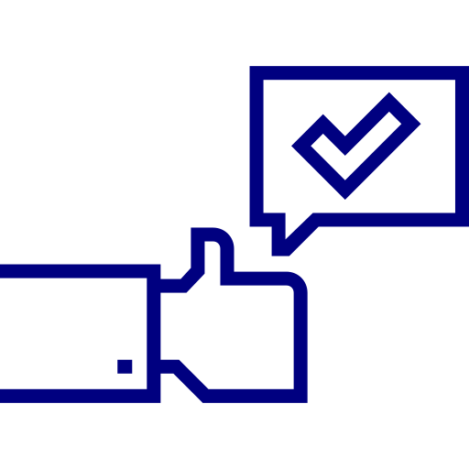
Intellectual Property
Identify
Invent
Implement
Copyrights
Exclusivity
Protect against functionality
Defensive moat
Trademarks
Freedom to Operate (FTO)
Trade secrets
Design
Patents
Time consuming
Expensive
Expiry
Utility
Notes:
In this session, we’ll be talking about how about you, as a founder of your digital health innovation, can protect your hard-fought intellectual property.
Intellectual Property (or IP) are the legal rights that protect your innovations against competitors, and are an important way to encourage and incentivise the innovation of new technologies in healthcare. There are lots of different types of IP rights for digital health tools, and include copyrights, trademarks, trade secrets, and – the one we’ll be spending the most time on today – patents.
Copyrighting is the most common form of IP protection for software, and Software as a Medical Device is often automatically protected under copyright law. You can also choose to register your product, for example with the Copyright Office in the US, in order to obtain proof of legal ownership and also sue for copyright infringement. Importantly, although copyrighting could protect your underlying code base, it doesn’t protect against competitors achieving the same functionality using different code. Therefore, you might need to think about other forms of IP protection, such as filing for patent protection, as we’ll come onto.
Trademarks, meanwhile, are necessary to protect your name, logo, or brand identity. It’s important you first conduct a trademark search to make sure the name you want isn’t already in use. If it isn’t, you can then file a trademark application, for example with Patent and Trademark Office in the US. Once your trademark is granted, you’ll also need to periodically submit declarations of use and renew your application.
Trade secrets are another way to precent confidential information being disclosed, including to your competitors. You’ll first need to identify the information that’s proprietary to you, define who is able to access this information and what the access controls are, and implement technical safeguards, such as encryption and regularly auditing who’s accessed them. You might want to also draw up non-disclosure agreements (or NDAs), both internally and when speaking with third parties, that prohibit them from disclosing your trade secrets.
Patents are most robust form of IP protection, but are also the most complex, particularly in the context of Software as a Medical Device.
If you do decide to file for a patent protection, it is important to be familiar with the type of patents that may apply to your innovation. Broadly speaking, these include utility patents, which protect the core product functionality, and design patents, which protect the appearance of the product (such as its Graphical User Interface (GUI)).
Utility patents must meet the criteria of being new, useful, and non-obvious. Importantly, SaMD inventions that simply automate otherwise human processes, such as scheduling an appointment, cannot be patented. On the other hand, more complex SaMD, for example using AI/ML techniques for computer vision and image processing, can be patented.
If your patent application is successful, you could be afforded the exclusive right to prevent others from making, using, importing, or selling a product, for a period of up to 20 years, and is therefore a source of sustained competitive advantage.
Patents are an additional safeguard to copyright law, in that they may prevent competitors from imitating your product functionality, in effect protecting what you’re doing, not just how you’re doing it.
Filing for a patent may however also represent a key strategic and business decision for your company, beyond just protecting your IP. They may be seen as an asset and increase the value of your company, make for a more attractive proposition for investors, and also be a moat to ward against competitors.
However, since all patent filings are ultimately published 18 months after filing, competitors may be able to see under the bonnet of your technology, and attempt to design around the patent.
In addition, patent applications are time-consuming and expensive to obtain, sometimes prohibitively so for start-ups. Importantly in the US, if you do plan on filing a patent, this needs to be done within one year of your first public disclosure, which is just another way of saying when you first presented your idea in a non-confidential way, for example at a conference or in a journal article. This is unlike elsewhere in the world, where a patent application needs to be filed before that first public-disclosure.
Before pursuing any of the IP rights we discussed today, you should first conduct a ‘freedom to operate’ (or FTO) analysis, in order to identify any existing patents or other IP protections you may be inadvertently infringing with your new invention. This typically involves a review of IP rights, such as patents and patent applications, trademarks, trade secrets, and copyrights.
FTOs are especially useful to look at the IP portfolio of your competitors to avoid any potential infringement claims. But sometimes, just because existing IP protections exist for another company, it might not be a dealbreaker, as you might be able to to buy or license other companies’ inventions if they are integral to product functionality.
We now move onto to the final session of the regulation section, as we consider the importance of information governance and data protection for digital health companies.

Slide 14
Business Planning
Identify
Invent
Implement
Patients
Healthcare providers
Employers
Insurers
Pharma
Consumerisation of healthcare
Limited reimbursement vs. established care pathways
Customer segmentation & marketing
Payment models
Demand validation
Time to scale
Rapid market scale
Population health, revenue generation, streamlining admin
Evidencing operational readiness
Reimbursement codes vs. new codes (vs. no codes)
Not mutually exclusive!
Improve patient care, reduce admin, and financial incentives
Population health, revenue generation, cost reduction
Clinical champions & user satisfaction
Innovation beds
Springboard ahead of enterprise deals
Payment models: FFS vs. VBC
Buy-up vs. direct purchase
Demonstrating value to the employer
Interplay with health insurance
Suite of product offerings
Relationship building
Notes:
Over the course of the next four lectures, we’ll be discussing about the potential customers you might be able to sell your digital health innovation to in the US: patients themselves, known as business-to-consumer (B2C) or direct-to-consumer (D2C), or healthcare providers, payers, and employers, known as business-to-business (B2B).
It’s also true that digital health companies can also sell to pharmaceutical companies, for example companies working on digital therapeutics (DTx), drug discovery, and clinical trial recruitment, but that’s not something we’ll be covering in this session, although many of the incentives remain the same.
Most of what we’re talking about, particularly in the context of selling to healthcare providers and insurers, is also very US-centric, and very different to if you’re selling into a single-payer system, like the National Health Service (or NHS) in the UK, for example. But hopefully, this section should get you thinking about the types of individuals and organisations you could sell to, what their motivations and incentives are, and what some potential reimbursement models might be.
Imagine you have a telemedicine company that has partnered with a commercial insurer, who may go on to offer your product to employers participating in their plan. In turn, HR teams at the employer may encourage employees to use your service, uptake of which is necessary for you to generate revenue.
And that’s without considering the physicians and healthcare providers that need to be on boarded onto your platform, in order to deliver the consultations.
Continuing with this example, the health plan would want ROI evidence to demonstrate that your company can deliver high quality care at a lower cost than their current vendors.
The employer meanwhile may wish to see how the use this of your platform could contribute to improved workforce productivity, whilst employees here would want a user-friendly interface and timely access to a healthcare professional.
And of course, physicians would want to evidence to suggest that working with your platform represents a lucrative opportunity, with access to a large network of patients, and getting a fair wage for their services.
Taken together, it is apparent that one of the biggest challenges for digital health companies is navigating the myriad stakeholders involved and aligning their many, often competing, incentives. In this B2B2B2C, or health plan -> employer -> HR team -> employee example, it is essential that all stakeholders, user personas, and motivations are mapped out, and that the incentives for each actor are evaluated.
Selling digital health solutions directly to patients (D2C) presents challenges due to patient reluctance to pay out-of-pocket for services previously covered by insurance. However, the rise in consumer-focused healthcare, post-COVID-19 expectations, and the mature D2C market in the US offer opportunities, especially for conditions like pain, mental health, and those involving dependents. D2C works well for products enhancing clinical outcomes and patient engagement, particularly in areas with limited reimbursement, like weight loss and sensory impairments. Care pathways with established reimbursement models, such as oncology, may not suit D2C. Effective customer segmentation, marketing, and targeted advertising are crucial in D2C sales, with payment models including freemium, subscription, and payment-per-use. While D2C allows validation of demand and evidence generation, it requires careful planning, significant marketing, and time to achieve scale compared to provider or payer partnerships. Different payment models have varying challenges and benefits, affecting adoption and user value.
When selling your digital health tool to healthcare providers, it's crucial to understand the differing motivations of individual physicians and the organizations they work for. Doctors seek tools that enhance direct patient care, reduce administrative tasks, provide clinical decision support, and offer financial benefits through increased patient interactions. In contrast, organizations focus on population health outcomes, including metrics like length of stay and readmission rates, alongside revenue generation and cost reduction. Convincing individual doctors may require identifying clinical champions who can advocate for your product.
If you’re targeting individual doctors and other users with your solution, you might have a harder time convincing the decision-makers and people that actually have purchasing power, as the benefits may not be immediately quantifiable. Therefore, identifying committed clinical champion(s), such as a head of department or other Key Opinion Leader (KOL), who is able to advocate for the product is essential. For example, imaging you’ve developed a solution that transcribes doctors’ consultations, converts them into a clinical note format, and automatically inputs it to the EMR. If you make a product so indispensable to doctors, you can create a groundswell of passionate und users, lobbying for your product on your behalf, like we saw with the productivity platform, Slack.
Demonstrating tangible metrics, such as revenue increase, can boost adoption likelihood. Familiarity with the hospital's structure and procurement processes, possibly with local advisors' assistance and innovation beds, is vital. Partnering successfully with healthcare providers can offer access to a significant user base and serves as a launchpad for larger enterprise deals. Various payment models, such as revenue sharing, flat rates (like 'per-member-per-month'), outcome guarantees, or gain sharing, can be explored based on the specific context and needs of the provider network.
When considering employers as potential customers for digital health tools, companies can either go through insurers or directly approach employers, especially smaller, self-insured ones. Direct partnerships with employers have become attractive for digital health firms due to shorter sales cycles and potential access to a broad user base. To appeal to employers, demonstrating a clear value proposition, such as improving employee productivity and reducing costs, is crucial. Focusing on diseases affecting a significant portion of the workforce is key, and products emphasizing wellness and wellbeing have been successful. Selling to employers often involves offering comprehensive solutions or partnering with other companies. Payment models can be based on active user engagement. Despite being more straightforward than dealing with health systems and insurers, selling to employers requires strong relationships and may necessitate hiring sales representatives, account managers, and technical support personnel.
Digital health companies often aspire to partner with payers like CMS and commercial insurers, aiming for rapid market scale. Selling to payers provides access to a vast network of in-network providers and patients. However, mere agreement with an insurer doesn't guarantee product usage, emphasizing the need for compelling evidence of real-world validation and performance.
Payers prioritize population health outcomes, revenue generation, and cost reduction, making solutions that streamline administrative tasks attractive. Identifying decision-makers within large payer organizations poses challenges.
Many companies initially sell to providers and patients to build evidence and operational readiness before approaching health plans. Some virtual care firms have succeeded in becoming in-network providers, leveraging existing reimbursement codes. However, retrofitting solutions onto existing problems might limit revenue. Creating purpose-built reimbursement codes is difficult but feasible. Alternatively, digital health companies can pursue payment models like subscriptions or hybrid approaches, combining subscriptions with risk-sharing elements.
Companies can start with providers, build evidence, expand offerings, and eventually sell to payers, maintaining relationships with initial customers concurrently. For instance, Oshi Health partners with employers and insurers while offering behavioral health services to healthcare providers

Slide 15
Pitch Deck
Title
Problem/Need Statement
Team Introductions
Problem Scoping
Introduce the Solution
Competitor Analysis
Market Analysis
Roadmap and Milestones
Notes:
In this penultimate session, we’ll be going through how to consolidate all of your learning throughout this course, and bring it all together into your pitch deck.
So what is a pitch deck?
Pitch decks are a short, succinct, and compelling way for you to showcase your innovation for the purposes of securing funding from investors, selling to customers, and more generally generating interest about your business. They’re a way to illustrate the problem you’re solving, your vision and ambition for the company, the size of the opportunity, and why you and your team are the people for the job.
Pitch decks will often vary depending on whom you’re presenting to, and it’s not uncommon for start-ups to have several different decks that vary in their breadth, messaging, and the elements they’re trying to highlight for a given audience. For example, a biotech firm trying to secure grant funding from a government research agency may spend longer on the results of its academic studies and clinical validation, than when they’re presenting to traditional venture capital firms.
A well-crafted pitch is key to attracting interest from VC funds and other investors, helping to articulate your value proposition and demonstrate product market-fit, and is often the starting point before entering into a dialogue, further screening, and due diligence. Moreover, for early-stage companies for whom a tangible product, meaningful revenue, or being cash positive is still a ways away, a good pitch helps to engender credibility in the eyes of investors.
With that said, let’s get into the components of a pitch deck. The caveat being that you’ll hear different people telling you different things about what sort of content to include, and the order to present them in. It’s important that you find what works best for you, and what – in your opinion – most clearly illustrates the points you’re trying to make:
You’ll want to start with a title slide, company logo, and maybe a one-liner summarising what your product does. There’s a tendency here to use meaningless buzzwords like “revolutionised” or “reimagined”, so just be cautious of that.
You’ll then want to set your stall for what the problem is that you’re trying to solve. This can be in the form of the needs statements we covered in the course, or using a problem statement, which could take the form of: “for population a unsatisfied with problem b, our company is a solution that x, y, z”. Another way to capture peoples’ interests is to present a vignette, and paint a picture of the user persona and pain points you’re solving for.
You might then want to introduce your team. Why are you the team for this job? What are your academic affiliations and relevant industry experience that means you’re well equipped and have the relevant skillset? You could consider including pictures of yourselves, as well as logos of your affiliations. Importantly, show humility. Understand that there might be gaps in your skillset, but that you’re actively looking to plug them. Moreover, be wary of giving yourselves titles, such as CEO, CTO, CFO, particularly if you’re a very early stage company, as the likelihood as you’ll all be mucking in and doing a bit of everything.
You may hear people tell you to save the team slide for the end, but personally I think it’s a good way to establish your credibility up front. Ultimately, it’s however you think you can tell your story the best.
Then go into no more than a couple of slides that go into how you’ve scoped the problem. What does the research suggest, and who are the KOLs and other stakeholders you’ve spoken to validate that this truly is an issue. Quotes are great for this, particularly if you’ve managed to speak to some real industry experts.
It’s now time to introduce your solution. What is it, how does it work, how do people use it, and – importantly – how does it address the problem you’ve identified. This is where mapping out the user journey is very helpful, so people can understand the bottlenecks with the status quo and where in the workflow your tool comes in.
Presenting the prototypes, and example interfaces, wireframes, and hardware components, will help to provide some context to what you’re doing and make it more tangible and less abstract.
An interactive demo or walkthrough video can also be engaging and enjoyable.
At this point, you might want to show how your product stacks up against its competitors. Who else is in this space, how similar or different to your product are they, and what do you offer that they don’t. Remember, it’s no good saying that there’s no competition or that there is and they’re all rubbish. Instead use this as an opportunity to play up your product differentiation and sources of competitive advantage. What’s the white space in this problem area you’ve identified that others haven’t?
You’ll then have to get into the meat of the deck. What’s the size of the opportunity here? How large is the market, is it an emerging market, how much market share can you realistically capture, and which market do you plan on take on first? Have you thought about what your go-to-market strategy is, and how you might get your foot in the door? What steps have you already taken to that end?
You’ll want to finish by talking about your next steps and roadmap. Do you need to do some more user testing of your prototype? Obtain further clinical validation? Establish a pilot study? This is a good opportunity to show investors that you’ve really thought about next steps and the milestones you’re working towards.
Finally, there are some more things you may want to cover in your pitch deck, such as your financial projections, unit economics, go into more detail on reimbursement, and regulatory and IP considerations. You might want to put these slides into an appendix at the end of the deck, and then refer to them after the presentation. It’s a good sign of preparedness when an investor asks you a follow-up question and you have the answer tucked away in a slide somewhere!

Slide 16
Break

Slide 17
1) Identify
Title
Problem/Need Statement
Team Introductions
Problem Scoping
Introduce the Solution
Competitor Analysis
Market Analysis
Roadmap and Milestones

Slide 18
Identifying areas of unmet need (5-10 mins)
Title
Problem/Need Statement
Team Introductions
Problem Scoping
Introduce the Solution
Competitor Analysis
Market Analysis
Roadmap and Milestones

Slide 19
Generating need statements (10 mins)
Title
Problem/Need Statement
Team Introductions
Problem Scoping
Introduce the Solution
Competitor Analysis
Market Analysis
Roadmap and Milestones
Notes:
Students to aim for max. 5

Slide 20
Need screening & selection (15-20 mins)
Epidemiology and Scope
Problem prevalence
Impact to patient
Problem understanding
Existing Solutions
# of existing solutions
Success of existing solutions
Stakeholder Analysis
Stakeholder concern
Access for target user
Switching costs
Market Analysis
TAM
Growing/shrinking market
Market trends
Regulatory and Reimbursement
Medical device
Intellectual property
Customers
Title
Problem/Need Statement
Team Introductions
Problem Scoping
Introduce the Solution
Competitor Analysis
Market Analysis
Roadmap and Milestones
Notes:
Students to pick favourite statement

Slide 21
2) Invent
Title
Problem/Need Statement
Team Introductions
Problem Scoping
Introduce the Solution
Competitor Analysis
Market Analysis
Roadmap and Milestones

Slide 22
Defining concept criteria (10 mins)
Efficacy
Safety
Must Have
Cost
Nice to Have
Usability
Access
Title
Problem/Need Statement
Team Introductions
Problem Scoping
Introduce the Solution
Competitor Analysis
Market Analysis
Roadmap and Milestones

Slide 23
’How Might We’ questions (10 mins)
‘Amp up the good’
‘Remove the bad’
How Might We?
‘Question assumptions’
‘ID unexpected resources’
‘Create an analogy’
Title
Problem/Need Statement
Team Introductions
Problem Scoping
Introduce the Solution
Competitor Analysis
Market Analysis
Roadmap and Milestones

Slide 24
Prototyping (10 mins)
Title
Problem/Need Statement
Team Introductions
Problem Scoping
Introduce the Solution
Competitor Analysis
Market Analysis
Roadmap and Milestones

Slide 25
3) Implement
Title
Problem/Need Statement
Team Introductions
Problem Scoping
Introduce the Solution
Competitor Analysis
Market Analysis
Roadmap and Milestones

Slide 26
Regulation, reimbursement & IP (15 mins)
Title
Problem/Need Statement
Team Introductions
Problem Scoping
Introduce the Solution
Competitor Analysis
Market Analysis
Roadmap and Milestones

Slide 27
Lightning pitches
Title
Problem/Need Statement
Team Introductions
Problem Scoping
Introduce the Solution
Competitor Analysis
Market Analysis
Roadmap and Milestones

Slide 28
Questions?

Slide 29
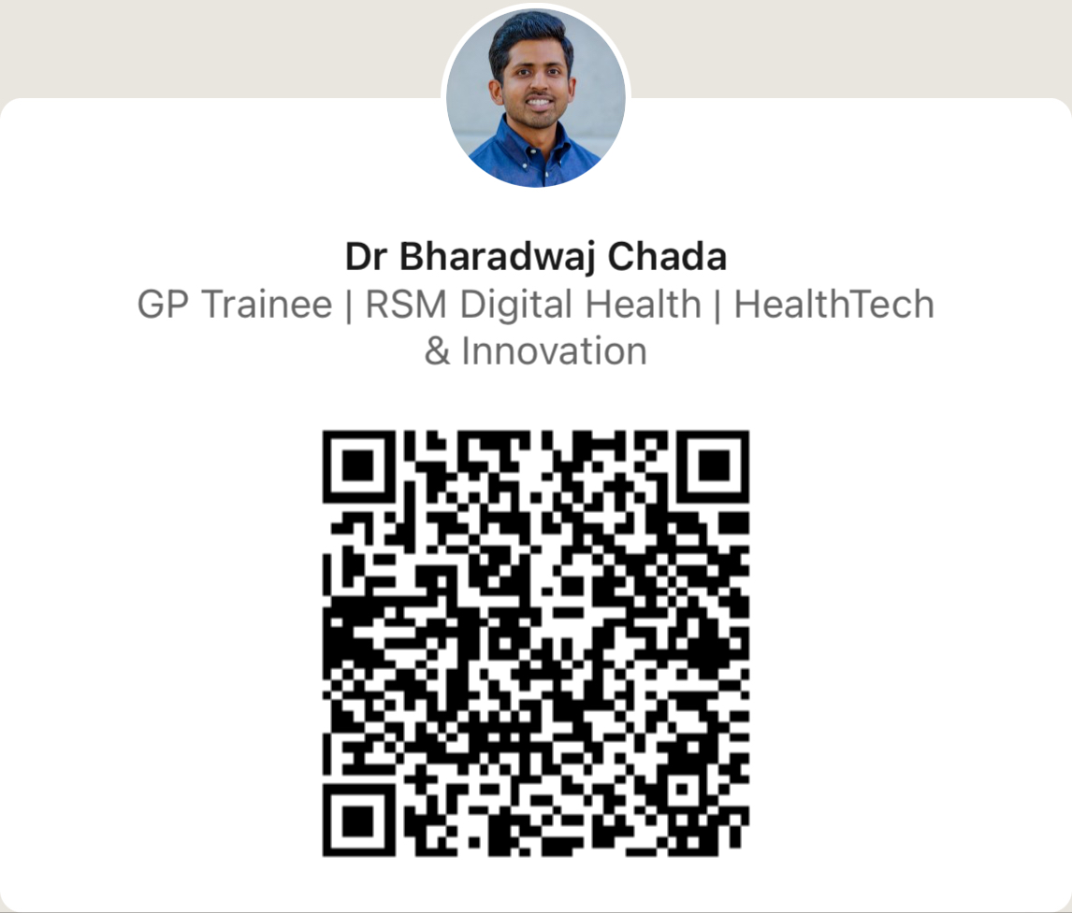
Thank you!
bharadwaj.chada1@nhs.net
Notes:
https://forms.gle/HGBR51D6YXzvosQE6

